Slide 1
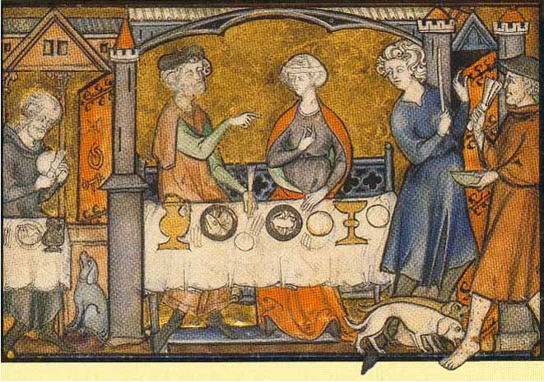
The Middle Ages

Slide 2
What was the Middle Ages?
Period of time from 500-1200
As the Roman Empire declined life became unstable in Europe
Germanic tribes invaded causing major issues
Disruption of trade
Downfall of cities
Population shift: urban to rural
Decline of Learning
Loss of Language
How would people survive??

Slide 3
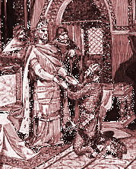
“Feudalism” Structures Society
A political and economic system based on land-holding and protective alliances

Slide 4
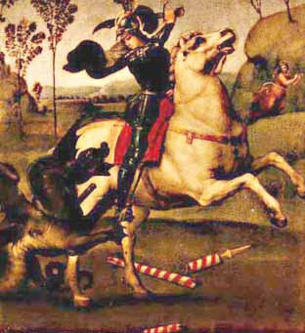
New Social Classes Formed
Landowners became “nobles” or “lords.”
They kept their own armies and controlled the supply of food.
They collected taxes from people.

Slide 5
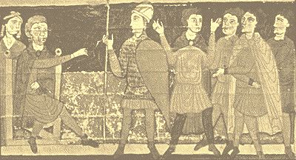
The Feudal Contract
One who received land from a lord was called a “vassal.”
The land given to a vassal was called a “fief.”
Based on an agreement:
A lord provided a vassal with a fief .
In return, a vassal provided a lord with military service.

Slide 6
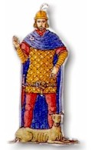
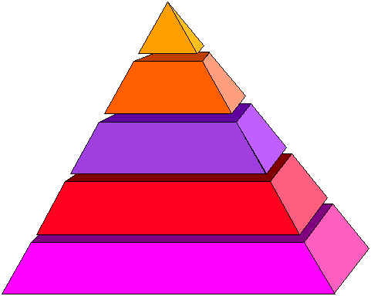
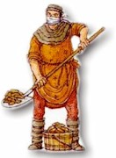
The Social Pyramid is Built
Top - The King.
Second - Nobles, bishops.
Third - “Knights.”
Last - Peasants and serfs.

Slide 7
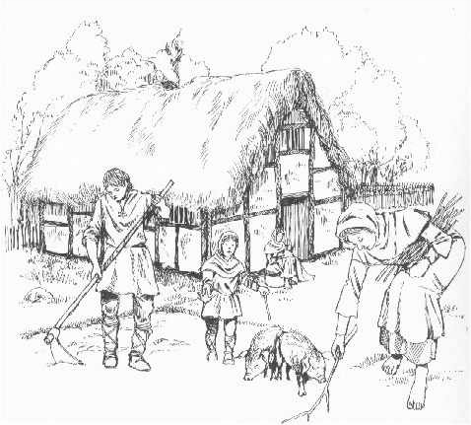
Peasants and Serfs
Common people were called “peasants.”
“Serfs” were tied to the land and could not leave.
But they were not slaves !
Both lived and worked on the lord’s land.

Slide 8
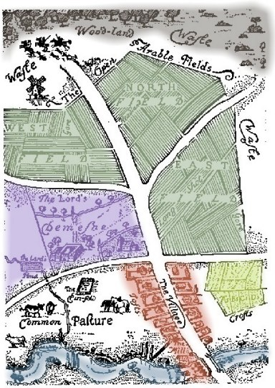
The Manor System
The lord’s estate was called a “manor.”
Manors were “self - sufficient”
Lords provided peasants with :
housing, land to farm, protection.
In return: Peasants worked for the lord.

Slide 9
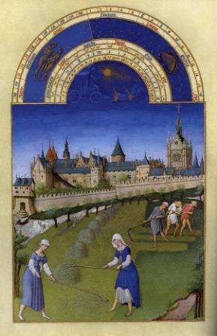
The Life of a Peasant was Hard
They owed several days of work each week to the lord.
Part of crops they grew were given to the lord.
They paid taxes to the lord for using his mill.
They paid a “tithe” to the church .

Slide 10
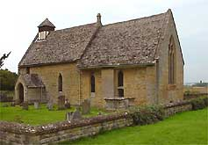
The Church
The Catholic Church was the only church in Europe.
A powerful presence in people’s lives, it had its own lands, laws and taxes.

Slide 11
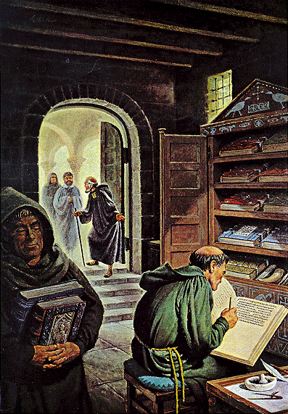
Life in a Monastery
Some men left a secular life to live in a monastery.
Monks
Every part of a day was spent in work, prayer or service to others.
Many monks took vows including silence, obedience, poverty.

