Slide 1
Operant Conditioning

Slide 2
Classical vs Operant Conditioning
Classical conditioning uses reflexive behavior
Operant conditioning uses voluntary behavior
Ask: Is the behavior something the animal can control? Does the animal have a choice in how to behave?

Slide 3
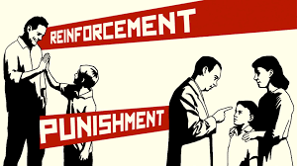
Operant Conditioning: Rewards and Punishments
A type of learning in which the frequency of a behavior depends on the consequence that follows that behavior

Slide 4
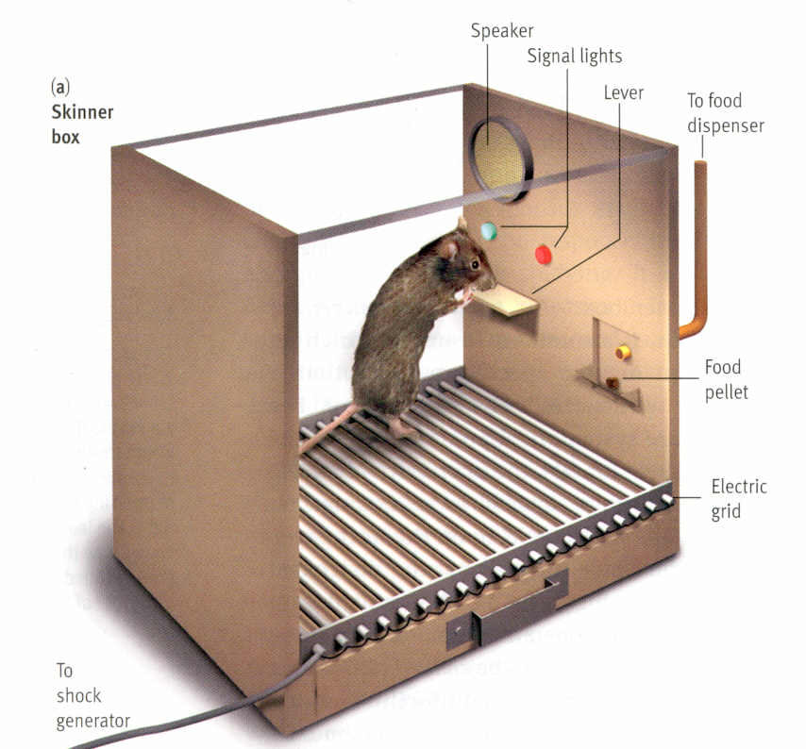
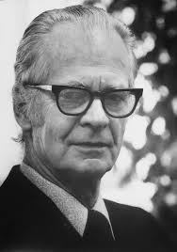
B.F. Skinner’s Famous Experiment

Slide 5
Reinforcement/Punishment
Reinforcement - Any consequence that increases the likelihood of the behavior it follows
Reinforcement is ALWAYS GOOD!!!
Punishment - Any consequence that decreases the likelihood of the behavior it follows

Slide 6
Reinforcing/Desirable Stimulus
Aversive/
UnDesirable
Stimulus
Stimulus is presented or added to animal’s environment…
Positive (+) Reinforcement
Add something you DO LIKE.
Behavior Increases
Positive (+) Punishment
Add something you DO NOT LIKE.
Behavior Decreases
Stimulus is removed or taken away from animal’s environment…
Negative (-) Punishment
TAKES AWAY something you DO LIKE.
Behavior Decreases
Negative (-) Reinforcement
TAKES AWAY something you DO NOT LIKE.
Behavior Increases

Slide 7
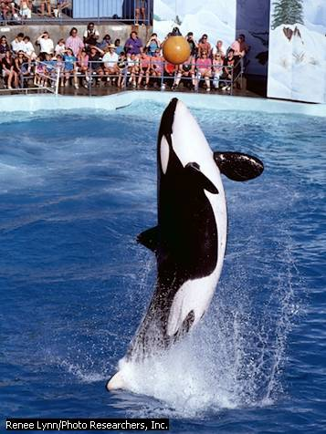
Other Terms
Shaping-mold a behavior
Discriminative Stimuli: cues that influence operant conditioning by indicating probable consequences of a response
Resistance to extinction-when an organism continues to make a response after reinforcer has been terminated

