Slide 1
Think Pair Share:
What makes a civilization “advanced”?

Slide 2
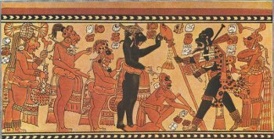
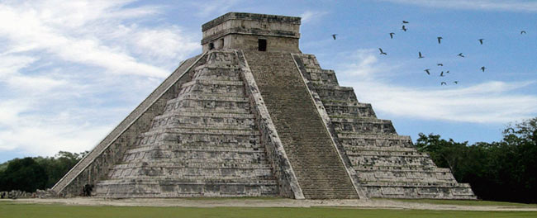
The Mayan Civilization
When?
200 BC-AD 900

Slide 3
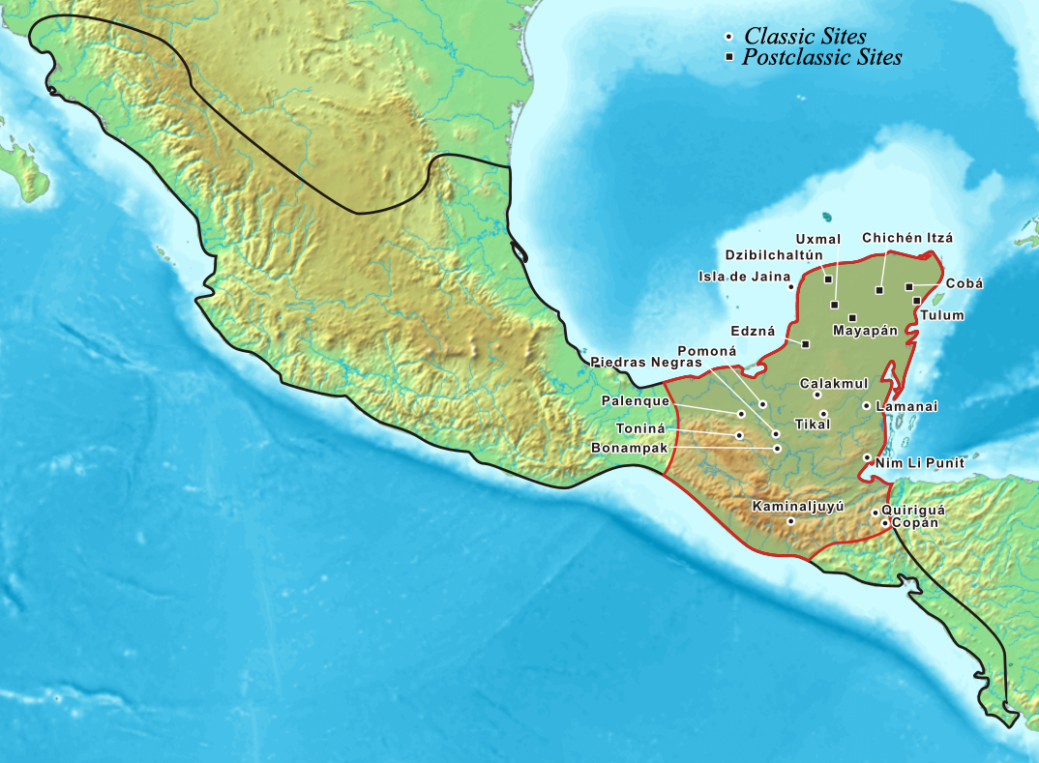
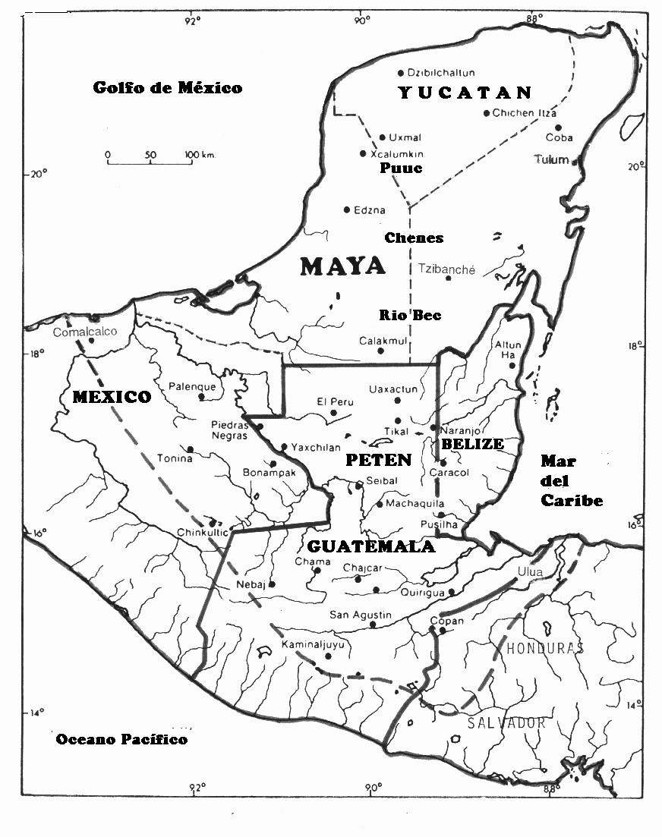
Where? Yucatan Peninsula. Southern Mexico into Northern Central America

Slide 4
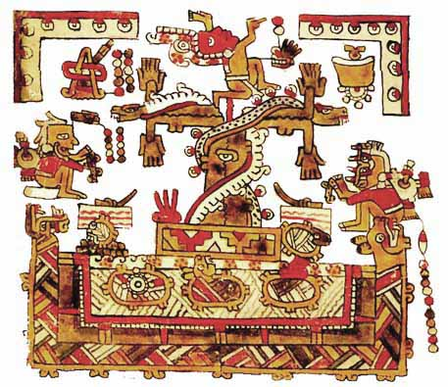
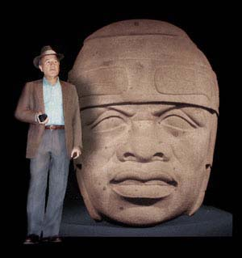
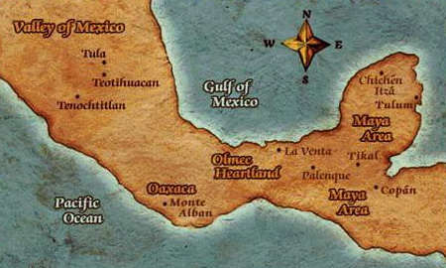
Olmecs
Gulf Coast
1200 B.C. – 400 B.C.
Influenced Mayan
Olmec Tree of Life

Slide 5
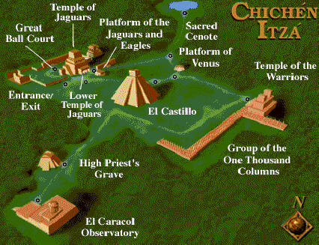
Classical Mayan Period
250 A.D. – 900 A.D
Important Cities
Tikal
Copan
Palenque
Uxmal
Chichen Itza

Slide 6
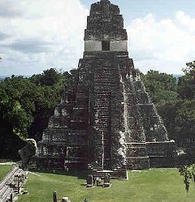
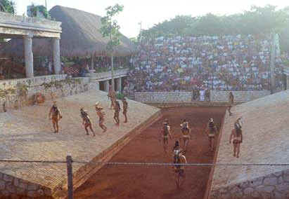
Mayan Cities
Independent city-states
Pyramids
Temples
Palaces
Stone Carvings
Ball Courts
Tens of thousands of people

Slide 7
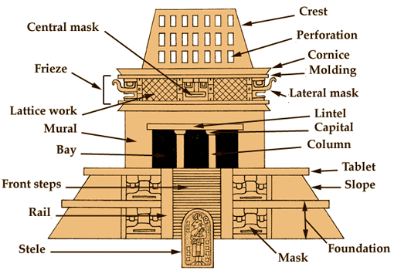
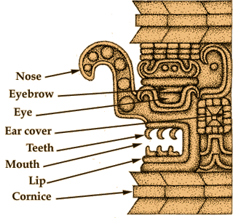
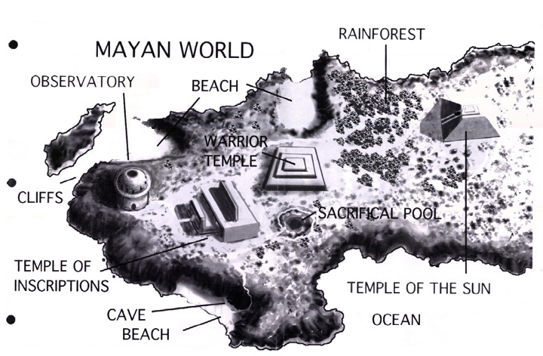

Slide 8
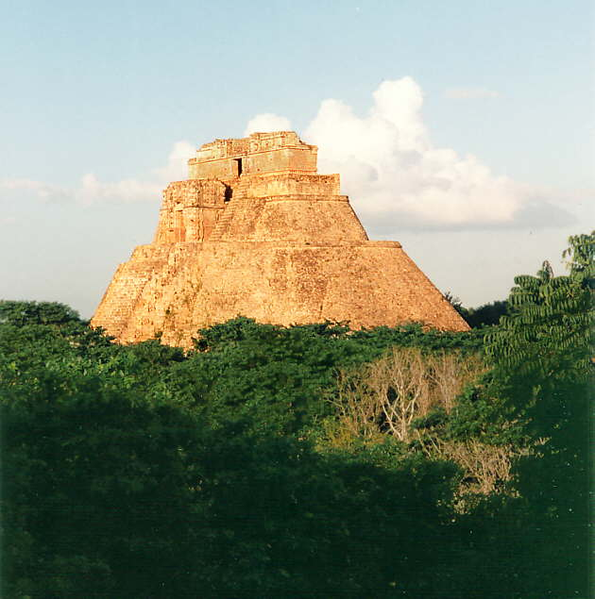
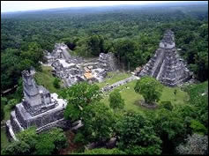
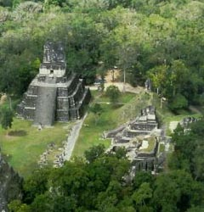

Slide 9
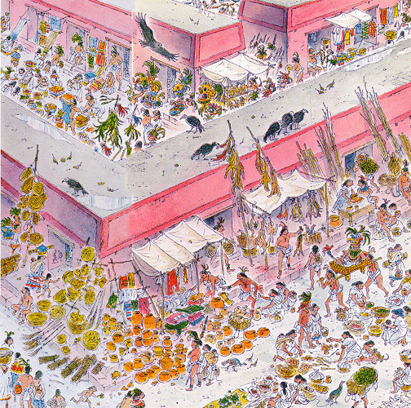
Linked Through Trade
Alliances & Trade networks
Salt, Flint, Feathers, Shells, Honey
Cotton textiles
Jade ornaments

Slide 10
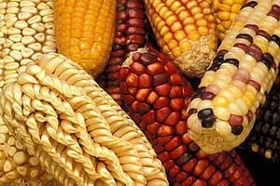
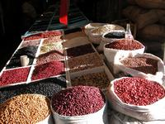
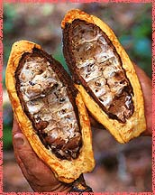
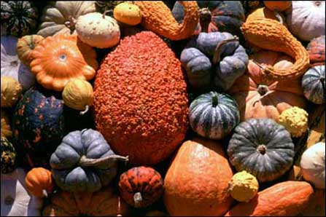
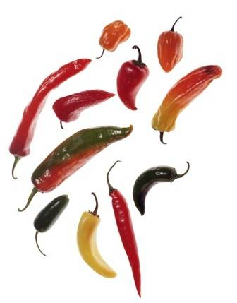
Mesoamerican Agriculture
Maize
Beans
Squash
Chilies
Cocoa

Slide 11
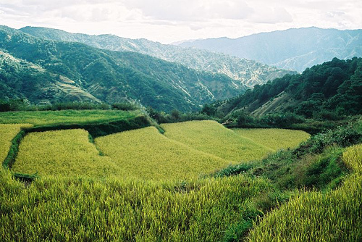
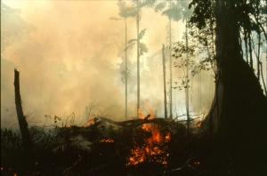
Farming Practices
Slash-and-burn
Hilltop terracing

Slide 12
Huge
Production
Trading
Social
Classes
Wealth

Slide 13
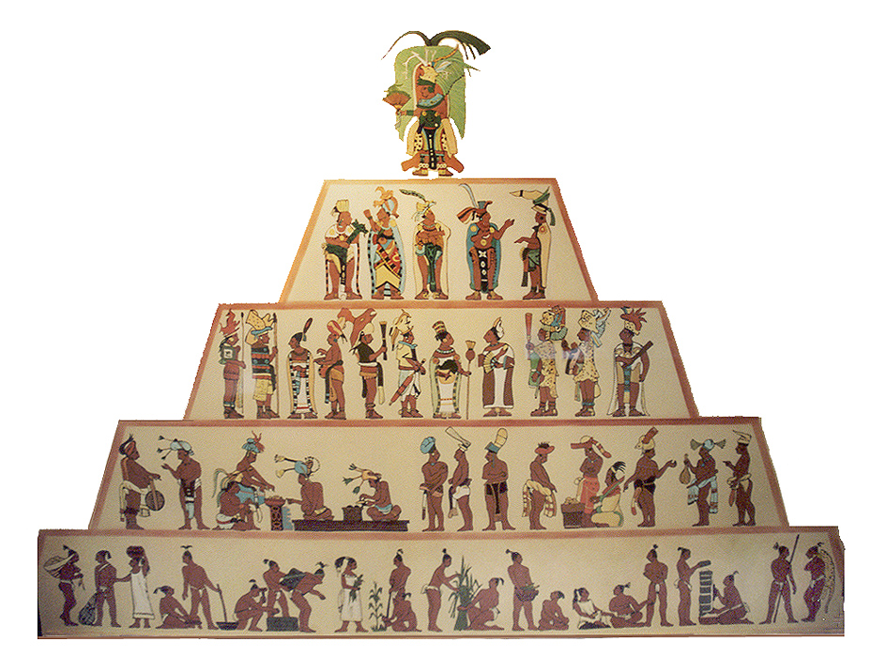

Slide 14
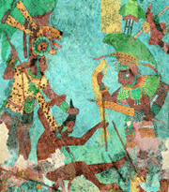
God-King
NOBLLS
Priests, Leading Warriors
MERCHANTS &
SPECIALIZED KNOWLEDGE
Master Artisans
PEASANTS

Slide 15
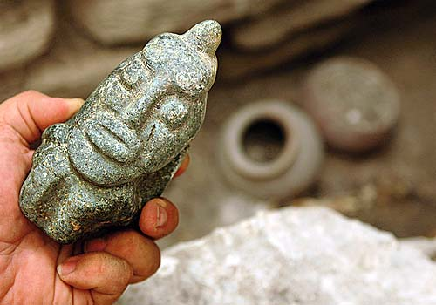
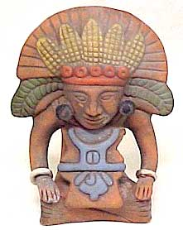
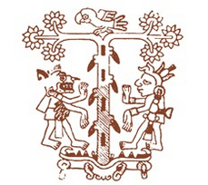
Religion Ruled Life: A God for Everything
Colors
Directions
Weather
Holidays
Birth / Death
Days
Corn, Cocoa
All Revealed in
Calendar
Carved effigy of the rain god Chac.

Slide 16
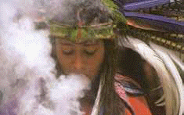
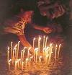
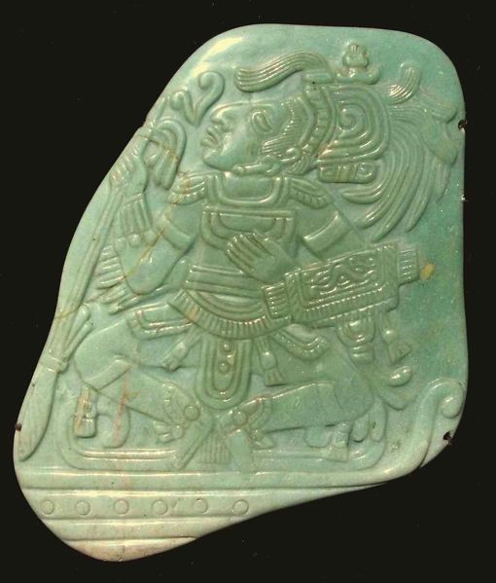
Religious Rituals
Offerings
Incense
Blood
Piercing
Human Sacrifices
cenote
Why? → Balance, Ultimate offering

Slide 17
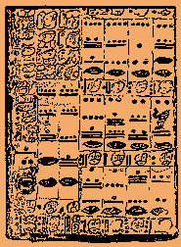
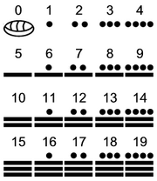
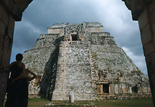
Amazing Feats
Mathematics
Astronomy
Calendar

Slide 18
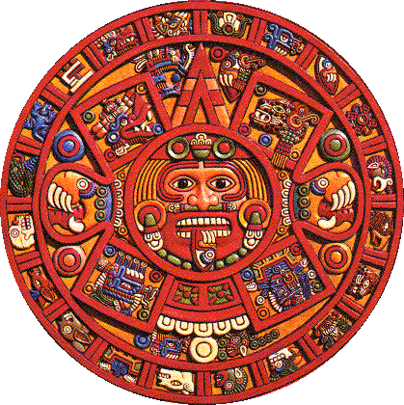

Slide 19
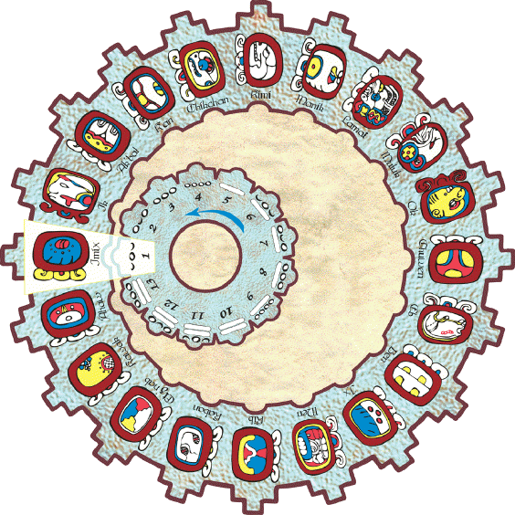
Mayan Calendar
260-day religious calendar
365-day solar calendar
Based on
OBSERVATION
Planets, sun, moon
MATHEMATICS
Zero, dots & bar

Slide 20
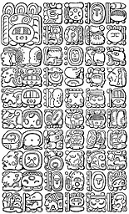
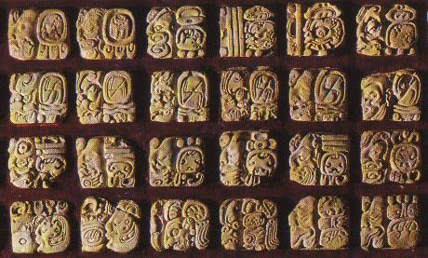
Writing System
Most advanced in ancient Americas
800 hieroglyphic symbols = glyphs
Historical events
Codex = bark-paper books (3)
Popol Vuh: most famous book about Mayan
creation myth

Slide 21
Mysterious Decline
Late 800s Maya abandoned cities. Why??
Fighting between city-states disrupted trade
Overfarming
Famine
Disease
overpopulation

