Slide 1
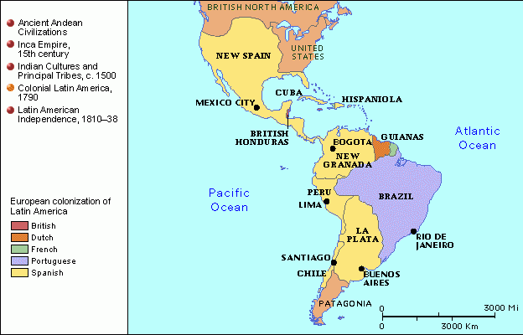
Latin American Independence Movements

Slide 2
Causes
Successful Revolutions:
American
French
Enlightenment Ideas
Ideas of Liberty, Equality, Democracy
Napoleon Takes Over Spain
Spain is weak

Slide 3
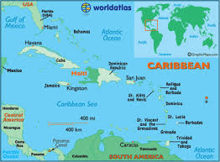
Revolution in Haiti
French colony of Saint Domingue
During French Rev the African slaves revolted
Led by Toussaint L’Ouverture
Former slave, became skilled general
1801 he controlled all of island, freed slaves

Slide 4
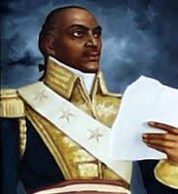
Haiti’s Independence
Jan 1802: French troops came to take it back
Toussaint agreed to halt revolution if French ended slavery
French accused him of planning another revolution!
Arrested him, died to prison 1803

Slide 5
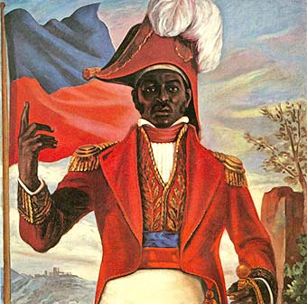
Haiti’s Independence
Jean-Jacques Dessalines, Toussaint’s lieutenant, took over
Jan 1, 1804: declared independence
“Haiti” means “mountainous land”

Slide 6
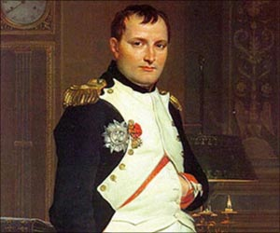
Creoles Lead Independence
1808 Napoleon conquered Spain
1810: rebellion broke out in Latin America
Two brilliant creole generals led independence:
Simon Bolivar
Jose de San Martin

Slide 7
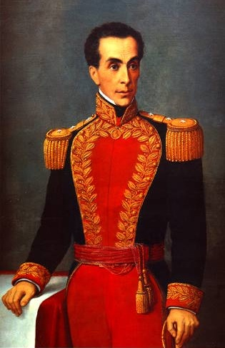
Simon Bolivar
Wealthy Venezuelan Creole
1811: Declared Independence
Bolivar’s army lost many battles
Aug 1819 turning point, won victory against Spain
1821: Venezuela won independence

Slide 8
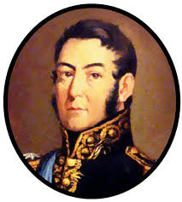
Jose de San Martin: “The Great Liberator”
Argentinian Creole
Argentina declared independence in 1816, but Spanish still in nearby Chile and Peru
1817: freed Chile along with Bernardo O’Higgins
1822: Martin gave Bolivar his army so that he could defeated Spain in Peru

Slide 9
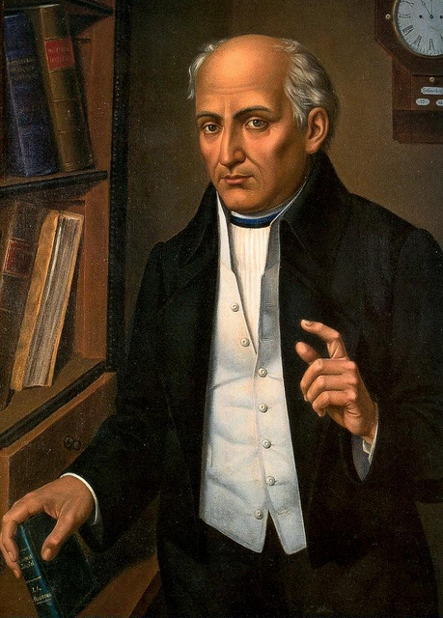
Mexico Ends Spanish Rule
In Mexico, Indians and Mestizos played leading role
1810 Padre Miguel Hidalgo, a priest in small village of Dolores, took first step towards independence
Poor but well educated, supported Enlightenment ideas
Sept 16, 1810 rang bells of church, issued call for rebellion against Spanish=grito de Dolores

Slide 10
Hidalgo’s followers began march next day toward Mexico City, 80,000 people!
alarmed Spanish army and creoles, worried loss of property and life
Army defeated Hidalgo in 1811
rebels then united around Padre Jose Maria Morelos: led rebellion for 4 yrs
1815 Morelos defeated by creole officer Agustin de Iturbide

Slide 11
Mexico’s Independence
1820 a liberal group in Spain took power, Mexican creoles worried they may lose privileges in colony so they united in support of Mexican independence
Iturbide proclaimed independence in 1821
Central America was part of viceroyalty of New Spain-governed from Spanish seat in Mexico
1821-several Central American states declared independence, but Iturbide refused, he was finally overthrown in 1823
Central America then declared independence from Mexico
United Provinces of Central America was made up of future countries of Nicaragua, Guatemala, Honduras, El Salvador, and Costa Rica

Slide 12
Brazil’s Royal Liberator
Brazil’s independence unique because no violence
1807 Napoleon invaded Spain and Portugal
Prince John(later King John VI) and the royal family fled Portugal, set up in Brazil
1815 Napoleon defeated, King John and gov’t returned to Portugal in 1821; Dom Pedro, King John’s son, stayed behind
Brazilians did not want to return to colony, 1822 creoles demanded independence, signed petition asking Dom Pedro to rule, he agreed
Sept 7, 1822 he officially declared Brazil’s independence

