Slide 1
Greek and Roman Contributions to Western Civilization
Quiz Answers

Slide 2
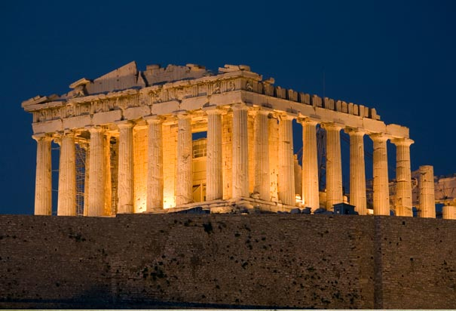
1. Describe the Parthenon. Which civilization built it? For what purpose?
It was built by Greece to honor Athena, the Goddess of Wisdom and the protector of Athens.
It was a 23,000 square foot temple

Slide 3
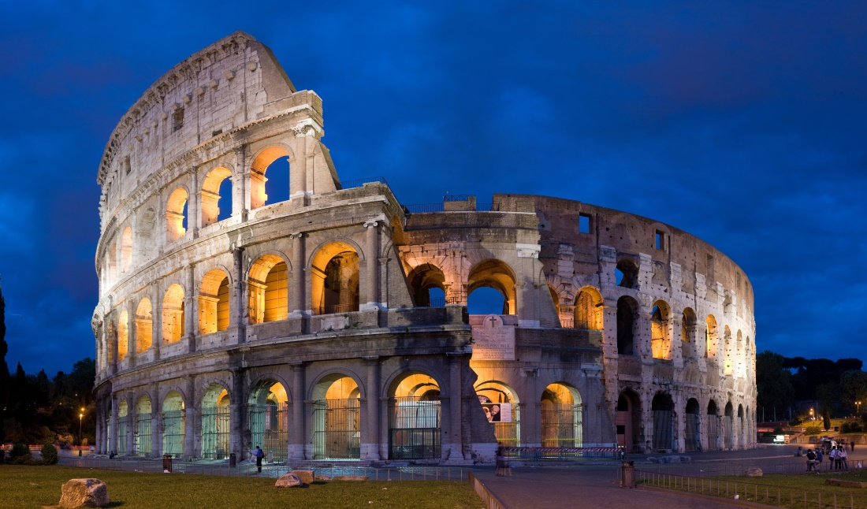
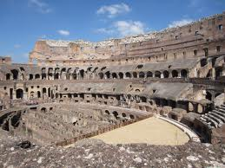
2. Describe the Colosseum. Which civilization built it? For what purpose?
It was built by Rome for entertainment. Animal hunts and gladiator fights occurred there.

Slide 4
3. What is classical art?
Classical art values harmony, order, balance, and proportion. It refers to Greek art.
This was a definition in your textbook-always take notes on definition terms!

Slide 5
4. Which Greek philosopher said “The Unexamined Life is Not worth Living?” Hint: he was condemned for “corrupting the youth” and sentenced to death by poison.
Socrates
He encouraged Greeks to question everything

Slide 6
5. Which Greek philosopher created the basis for the scientific method?
Aristotle

Slide 7
6. Which Greek philosopher wrote The Republic?
Plato
He was a student of Socrates

Slide 8
7. How was Roman art different from Greek art?
Greek art portrayed ideal beauty, not realism
Roman art was more realistic and practical

Slide 9
8. The most important legacy of Rome is its system of law. List two of the important principles of Roman Law.
1. Innocent until proven guilty
2. Equal treatment under the law
3. Burden of proof rests with the accuser
4. Punishment for actions, not thoughts!
5. Laws that are unreasonable or unfair can be thrown out.

Slide 10
Drama (Greece)
The Greeks invented drama, built the first theaters in the West
Two kinds of plays
Tragedy
Comedy
Actors dressed in colorful masks and costumes
Plays were for civic pride, tribute to the Gods

Slide 11
Literature and History
Greece:
Herodotus wrote the first history book
Epic poems of Homer
Thucydides: studying the past helps us understand the present
Rome:
Virgil wrote the most famous book: Aeneid
Livy wrote a history of Rome
Tacitus was a Roman historian

Slide 12
Art and Architecture
Greece:
Ex: Parthenon
Portray ideal beauty, not realism
Classical art
Sculpture and pottery very popular
Rome:
Ex: Colosseum
More realistic, practical
Learned much from Greece
Mosaics, paintings, murals popular

Slide 13
Philosophy (Greece)
Philosophers=lovers of wisdom
Socrates:
Encouraged people to question everything
Condemned to die for “corrupting the youth” and “neglecting the Gods”
Aristotle:
Scientific method
Plato:
The Republic

