Slide 1
Eight Features of Civilizations

Slide 2
What is a civilization?
A complex culture with eight(5 according to your textbook) characteristics
An advanced state of human society, which includes a high level of culture
What is culture? A group of peoples’ way of life.

Slide 3
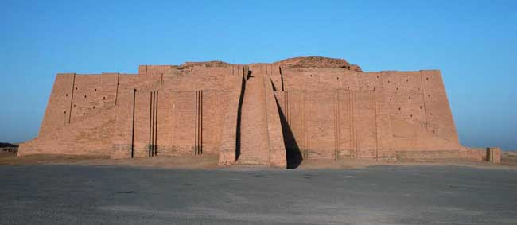
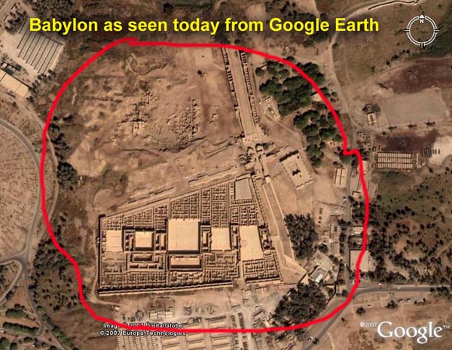
Cities
As farmers settled in fertile areas they began to grow extra, or surplus, food.
This extra food increased the population of the settlement, which led to cities
Top Picture: Ur in Sumer
Bottom: Babylon in Mesopotamia

Slide 4
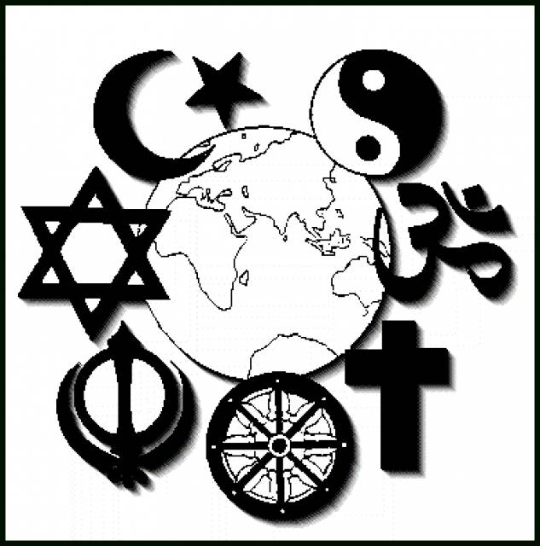
Complex Religions
As cities grew religion became a formal institution
Temples were built, people became priests

Slide 5
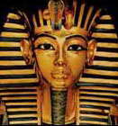
Central Governments
Why would a government be needed?
To oversee food supply, irrigation system, etc.
Large populations needed a system of ruling=government
Government is an institution: long-lasting pattern of organization in a community

Slide 6
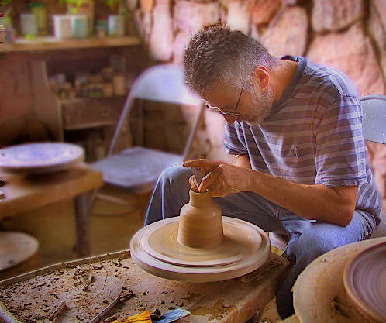
Job Specialization
Definition: the development of skills in a specific kind of work; breaking down jobs into simpler tasks
Started because of food surpluses
Exs: traders, government officials, priests, artisans(skilled workers who make goods by hand)
Why is job specialization important for the success of a society?

Slide 7
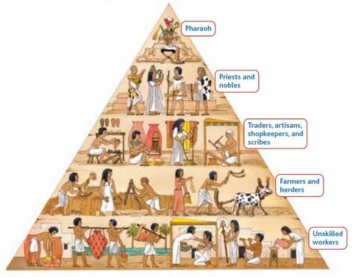
Social Classes
As jobs became specialized so did the need for social classes
Are social classes good for society?

Slide 8
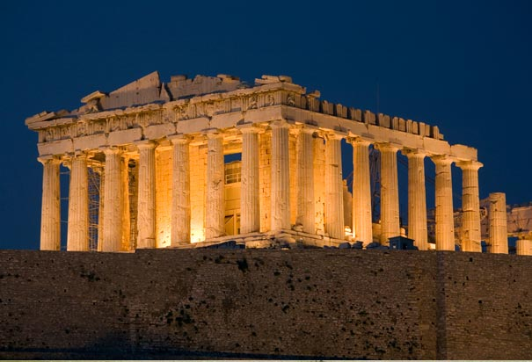
Art and Architecture
Expresses beliefs and values of a civilization
Different styles were developed and then copied by other societies
Built to impress visitors
Greek Parthenon

Slide 9
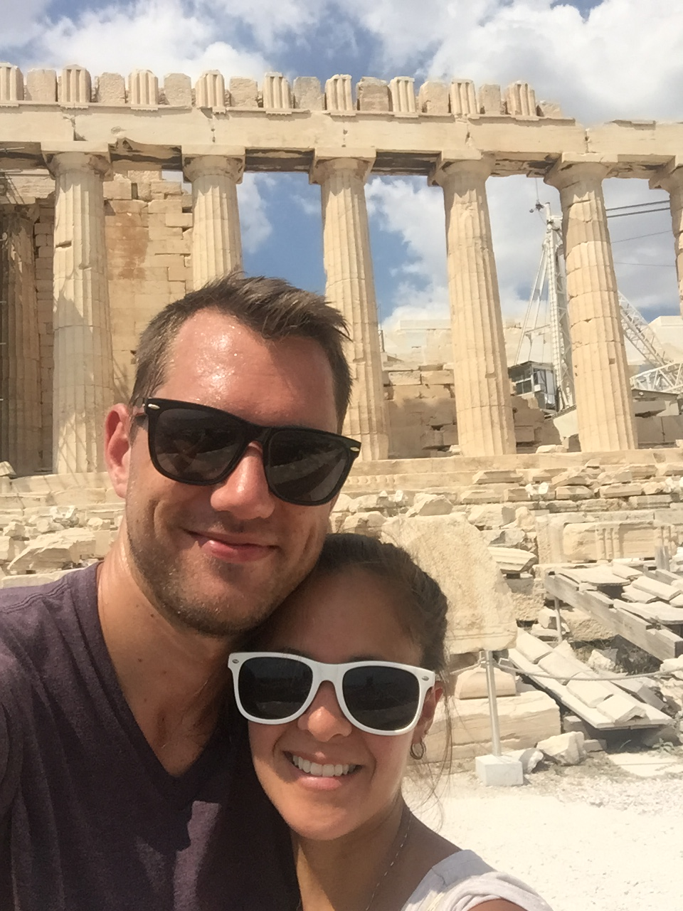

Slide 10
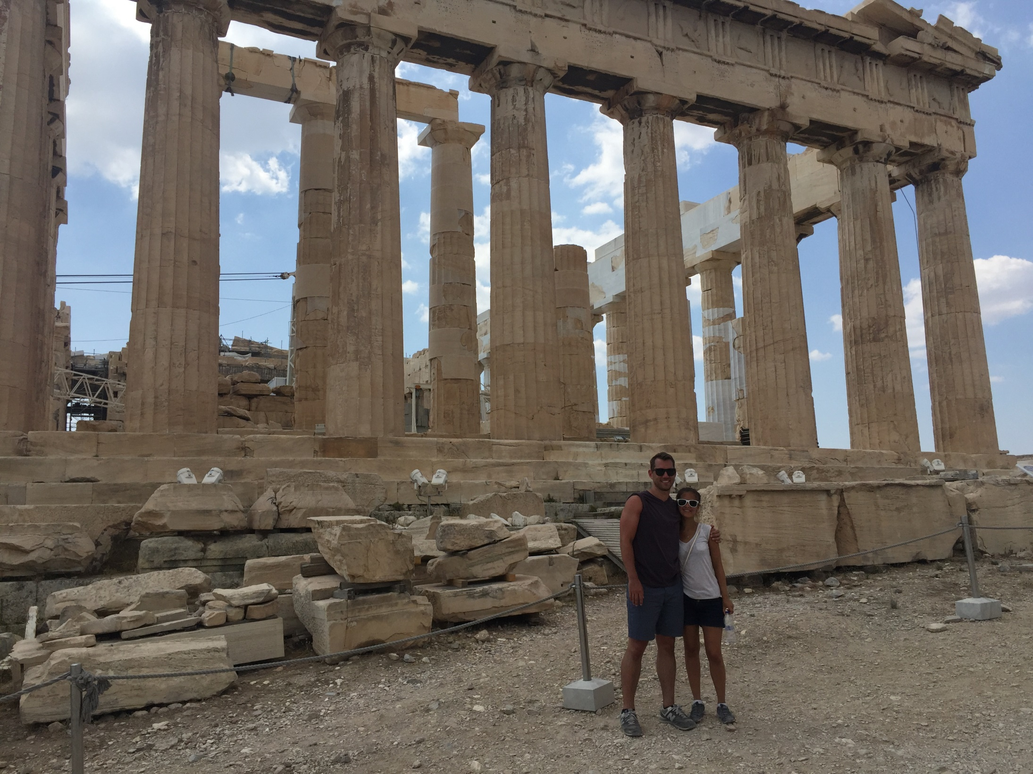

Slide 11
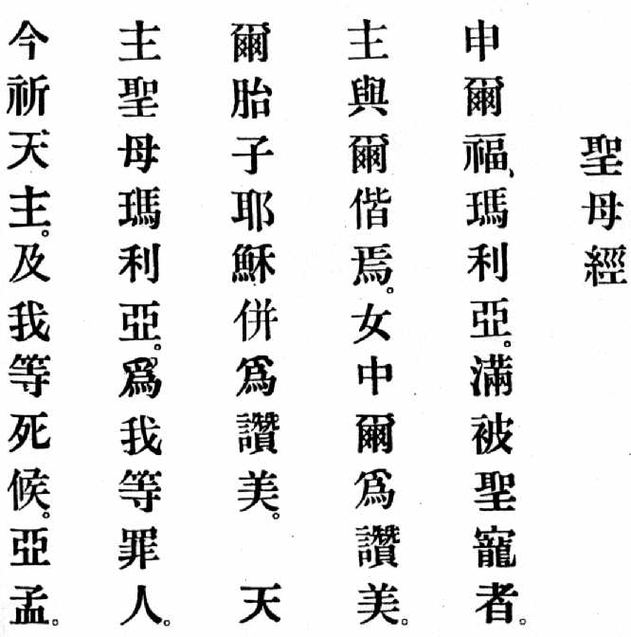
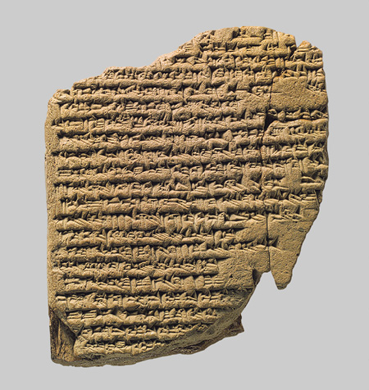
Writing
As society became more complex people realized need to keep records
Most civilizations developed system of writing
Others developed different system
Ex: Sumerian’s cuneiform

Slide 12
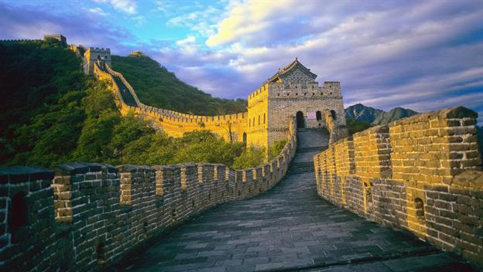
Public Works
The government would order these to be built to help the people.
Exs: a wall for protection, an irrigation system, or roads.

