Slide 1
Clinical Psychology

Slide 2
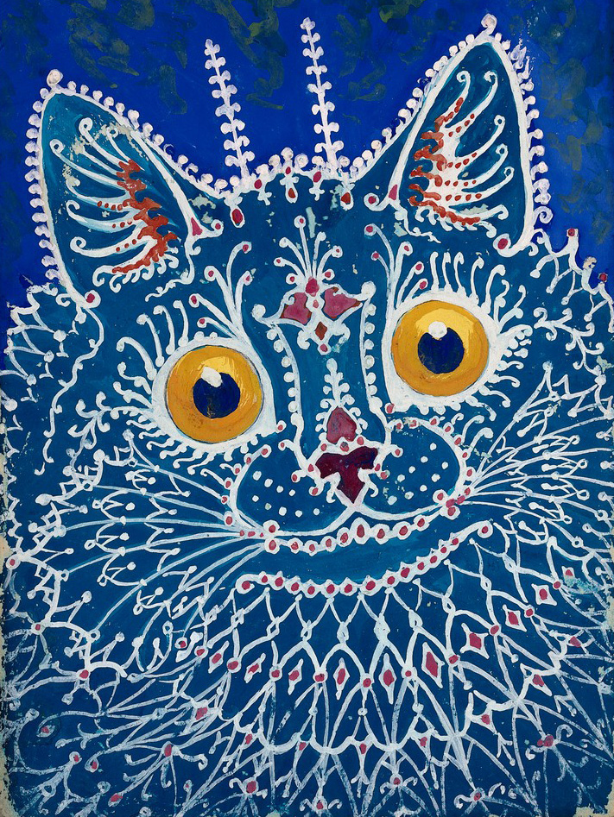
“Voices, like a roar of a crowd came. I felt like Jesus; I was being crucified. It was dark. I just continued to huddle under the blanket, feeling weak, laid bare and defenseless in a cruel world I could no longer understand.”
-Stuart, diagnosed with Schizophrenia

Slide 3
Points to Remember:
Be sensitive
Diagnosis is difficult-do not go home and diagnose your little brother.
Awareness leads to understanding, research, and decreasing the stigma surrounding mental illness.

Slide 4
450 Million people suffer from mental or behavioral disorders (WHO, 2008) Lifetime prevalence is 44%

Slide 5
How has your life been touched by mental illness?

Slide 6
What does “abnormal” mean?

Slide 7
Factors of Abnormality
It is harmful and disturbing to the individual
It is disturbing to others
It is unusual for the population
It is irrational; it does not make sense to the average person

Slide 8
Sean, a 29 year old salesman, was referred to a clinical psychologist by his girlfriend because of his inability to sleep and tendency to become preoccupied with minor matters. He once drove home two hours from a business meeting out of fear that he forgot to lock the front door. He gets along well with people, and these tendencies have been relatively recent. He also has a history of high blood pressure. Money has been tight lately, and he is worried he won’t be able to pay off his student loans or buy a house anytime soon.

Slide 9
What causes psychological disorders?

Slide 10
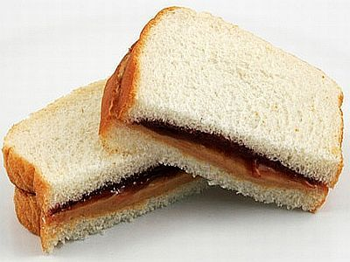
Diathesis-Stress Model
Combination of predisposition and stress
i.e. Family History of Anxiety No Major Life Stressors

Slide 11
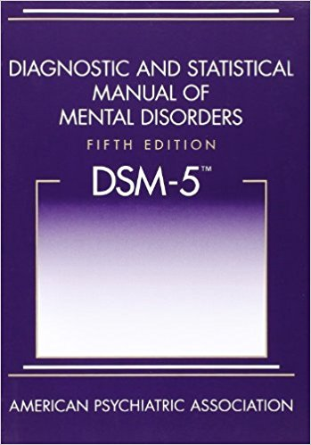
Does NOT discuss treatment OR causes. Why?

Slide 12
Other terms to know:
Epidemiology: Study of the distribution of disorders in a population
Etiology: Causes of disorders
Comorbidity: The coexistence of two or more disorders

Slide 13
Culture-Bound Disorders

Slide 14
Anorexia Nervosa: rarely seen outside of western cultures
Dissociative Identity Disorders: 79 cases before 1970. By the 1990s, over 40,000 cases

Slide 15
Susto: Latin America; “spirit attack” ; severe anxiety, restlessness and fear of black magic
Koro: Southeast Asia; “shrinking penis”; men have intense fear that their penis will withdraw into one’s abdomen, causing death
Winigo: Algonquin Indians; intense fear of being turned into a cannibal by a supernatural monster

Slide 16
Problems with labeling psychological disorders?

Slide 17
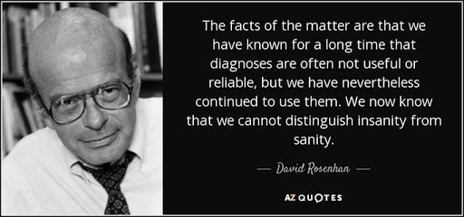
Rosenhan Study
Once a label is attached to someone, we may see them differently
Confirmation Bias

Slide 18
Takeaways from Rosenhan Study
“Stickiness of the Label”-Should people carry diagnosis label for the rest of their life?
To what extent are disorders the product of the environment or the individual?
If imposters can go undetected, what is the level of institutional care?

Slide 19
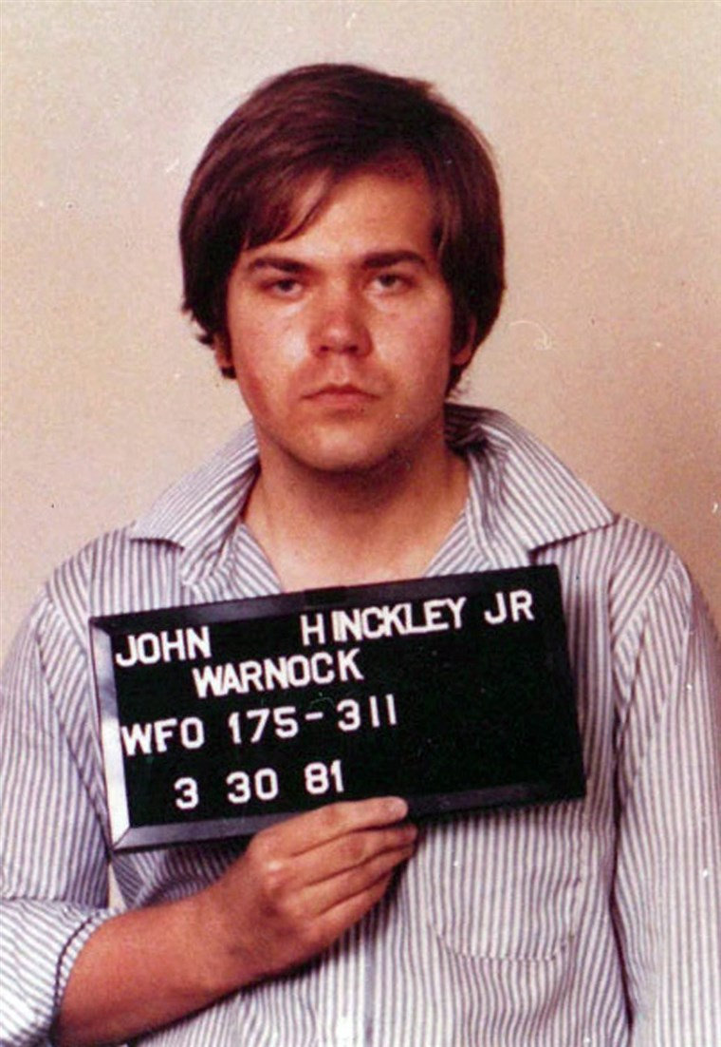
What does it mean to be insane?

Slide 20
People widely overestimate the number of people who use the insanity defense. Why?
Availability Heuristic: basing the probability of an event on the ease with which relevant instances come to mind

Slide 21
Six Classes of Disorders

Slide 22
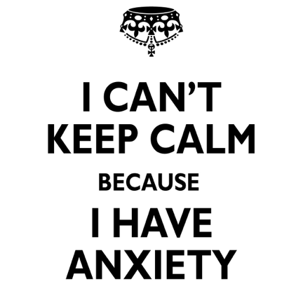
I. Anxiety Disorders (4)
Definition: Class of disorders marked by feelings of excessive fear and anxiety
Prevalence: 19% (Most Common)
More common in females (2:1)
Etiology:
Moderate genetic predisposition
Behavioral
Stress
Cognitive: certain types of thinking

Slide 23
What would each perspective say causes anxiety?

Slide 24
Generalized Anxiety Disorder
Chronic, low level of anxiety not tied to any specific threat

Slide 25
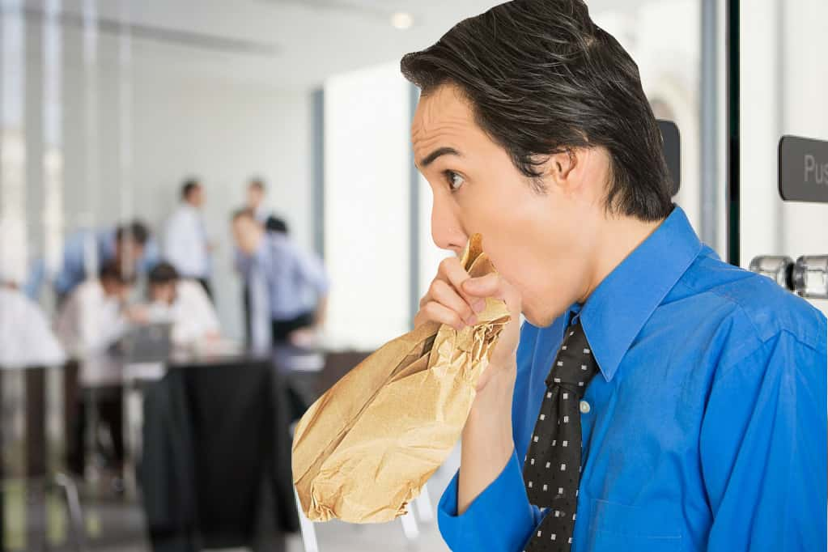
Panic Disorder
Person experiences sudden episodes of intense dread

Slide 26
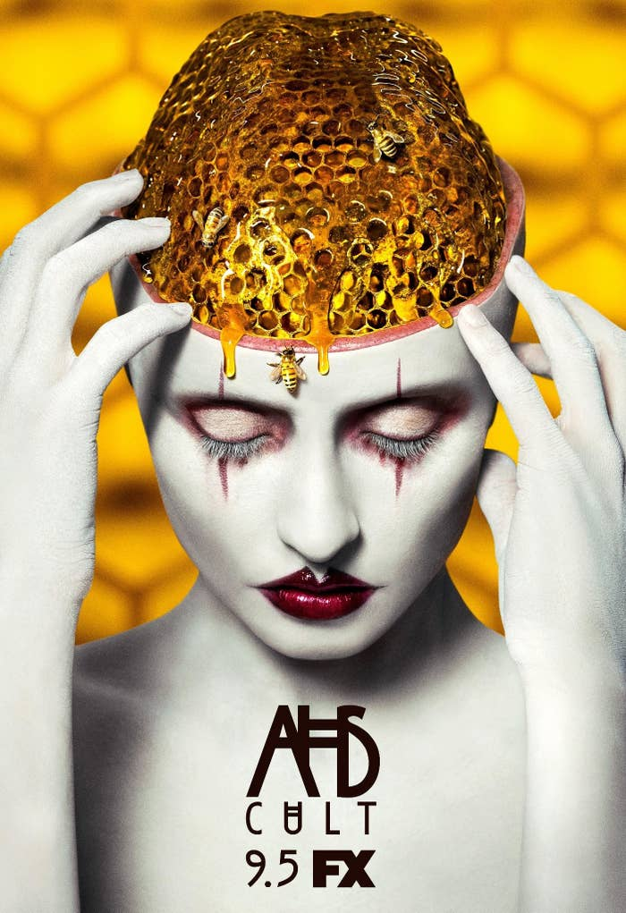
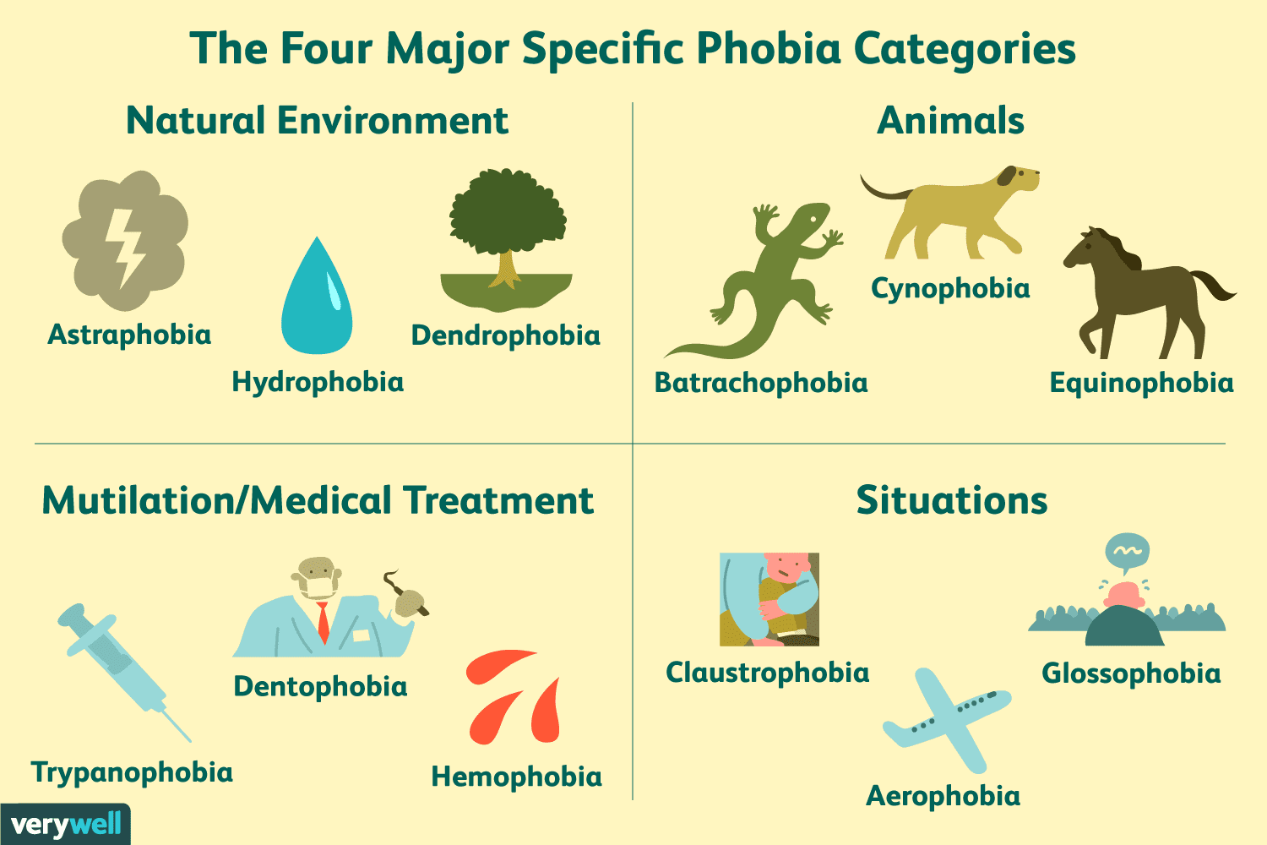
Phobic Disorder
Irrational fear causes person to avoid some object, activity, or disorder

Slide 27
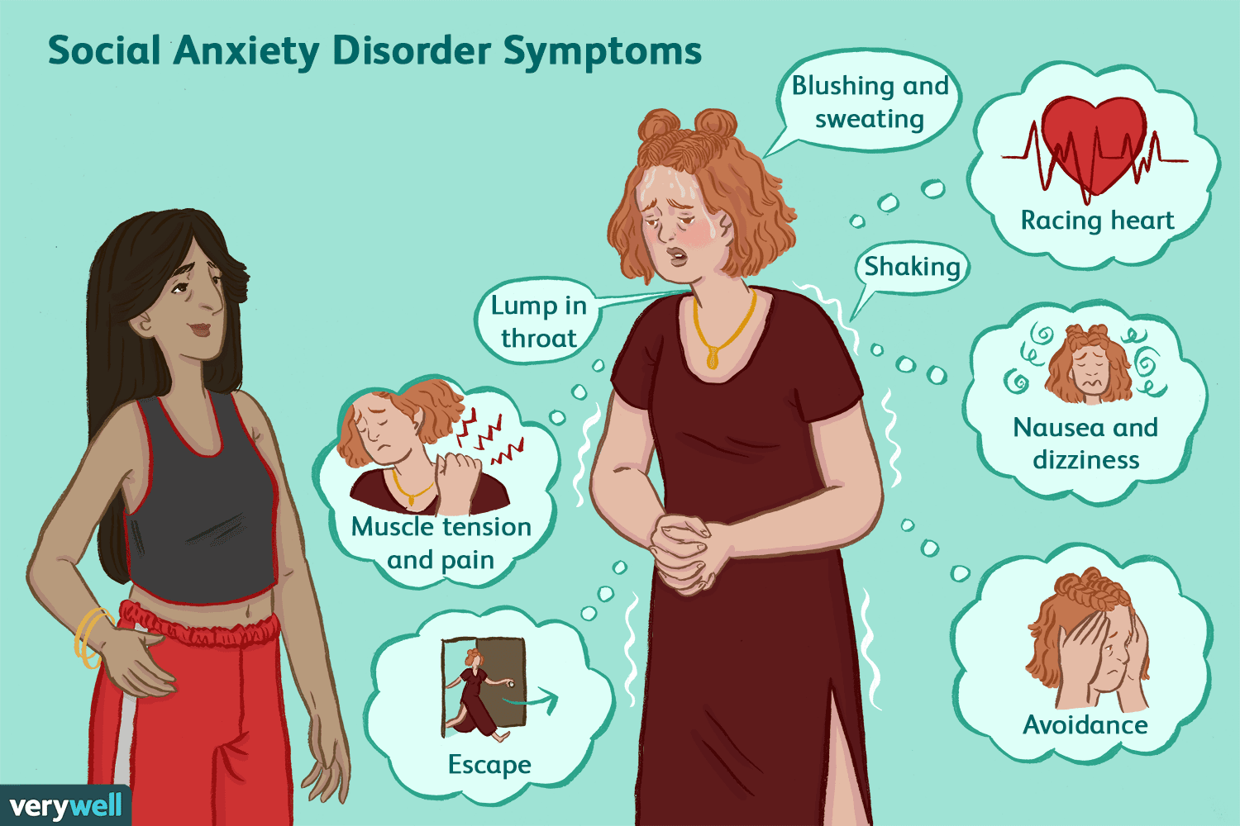
Social Anxiety Disorder
Fear of public embarrassment

Slide 28
*Obsessive-Compulsive Disorder*
Now listed under “Obsessive-Compulsive and Related Disorders”
Characterized by unwanted, repetitive thoughts (obsessions) and actions (compulsions)

Slide 29
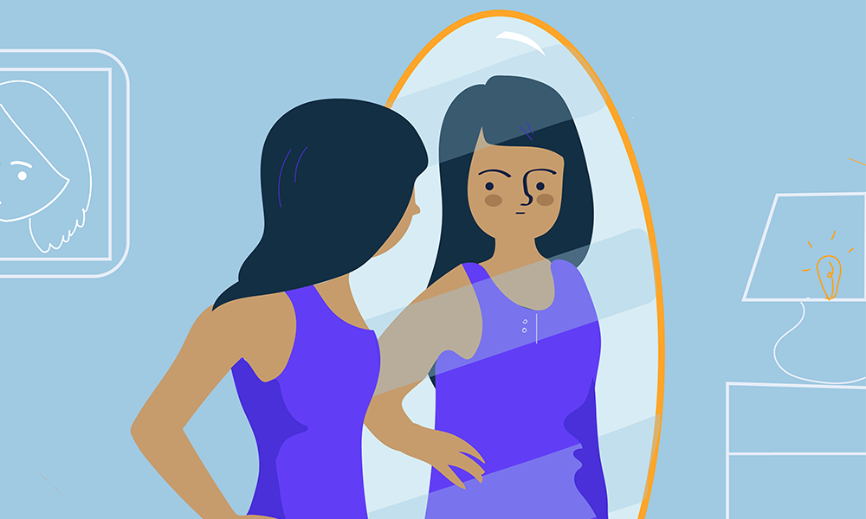
*Body Dysmorphic Disorder*
Persistent and intrusive preoccupations with imagined defect in one’s appearance

Slide 30
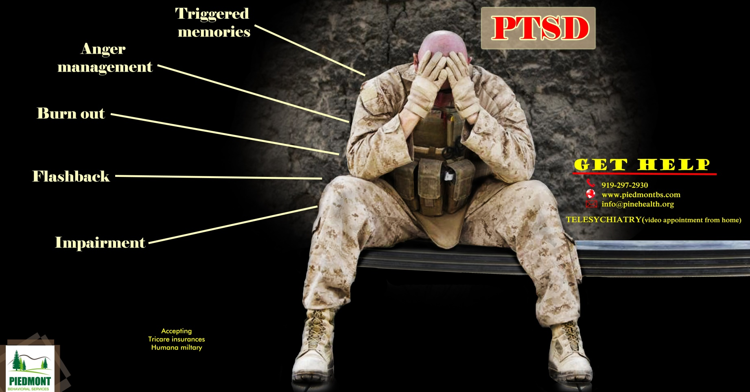
*Post Traumatic Stress Disorder*
Now listed under “trauma and stressor-related disorders”
Enduring psychological disturbance attributed to major trauma

Slide 31
II. Dissociative Disorders *controversial (2)
Definition: Class of disorders marked by a disruption of normal mental processes involved in memory, consciousness, identity, or perception
Prevalence: 2% (Rare)
Etiology
Childhood Trauma / Extreme Stress
Behavioral (it’s rewarding to forget)

Slide 32
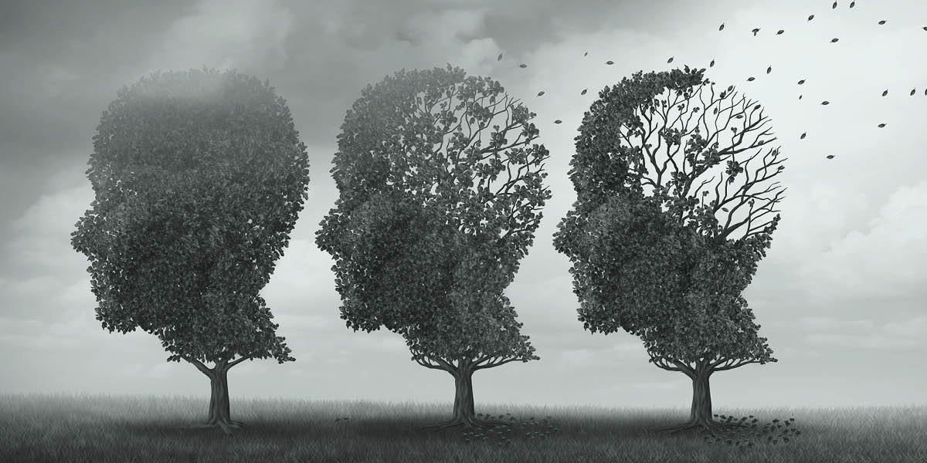
Dissociative Amnesia
Sudden inability to recall extensive and important personal information
With Fugue: sudden, unplanned travel

Slide 33
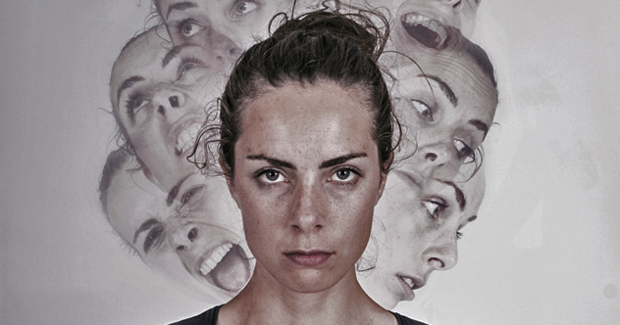
Dissociative Identity Disorder (DID)
Two or more personalities exist within a single individual

Slide 34
III. Somatic Symptom and Related Disorders *Reduction in DSM-5 (5)
Definition: Manifesting a psychological problem through a physiological symptom
Epidemiology: 3% (Rare)
Etiology
Psychoanalytic
Outward manifestations of internal conflict
Behavioral
Patients are being reinforced with attention

Slide 35
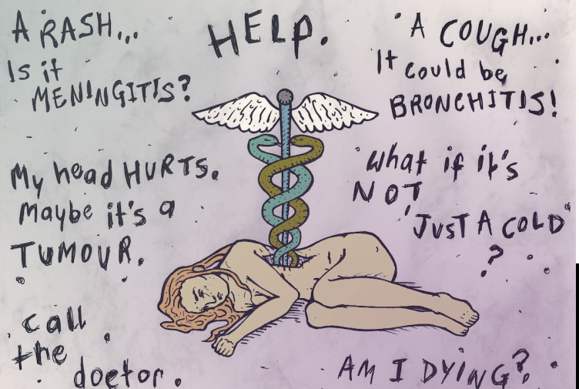
Somatic Symptom Disorder
Illness Anxiety Disorder
Formerly hypochondriasis
Frequent complaints without cause, OR minor issues become major
Main concern is symptoms
Use this diagnosis if the focus is on the FEAR of a disease

Slide 36
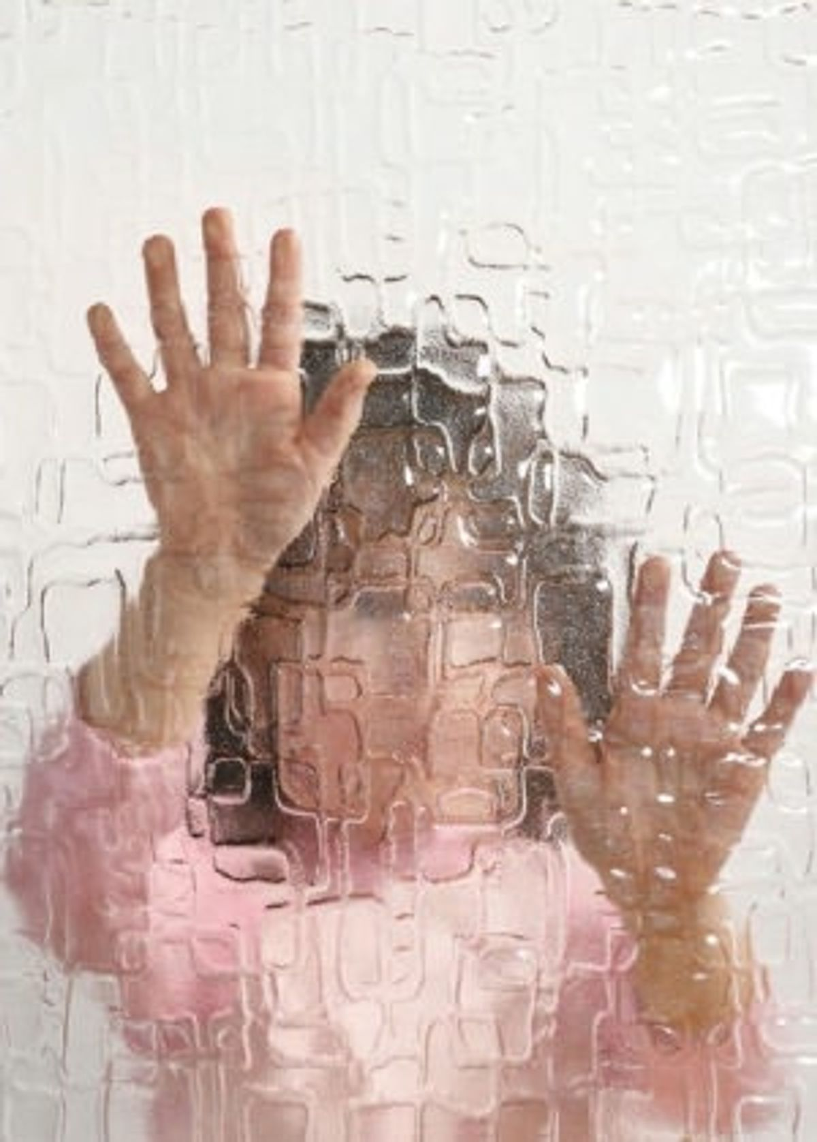
Conversion Disorder
Characterized by a severe physical problem like paralysis or blindness, but there is no biological cause

Slide 37
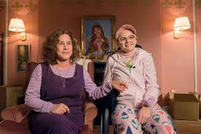
Factitious Disorder (Munchausen’s)
A person falsifies physical or psychological symptoms, with the absence of external rewards
Factitious Disorder Imposed on Another
A person falsifies physical or psychological symptoms IN ANOTHER PERSON; again, absence of external rewards

Slide 38
IV. Depressive Disorders and Bipolar Disorder (3)
Definition: Characterized by extreme or inappropriate emotions
Epidemiology: 13-14% (common)
Etiology
Biological
Serotonin imbalance or Genetic vulnerability
Cognitive
Learned helplessness
Stress

Slide 39
Major Depressive Disorder
Characterized by depressed mood for at least two weeks in the absence of a clear reason
Common symptoms include
loss of appetite
Fatigue
feelings of worthlessness
lack of interest in normally enjoyed activities

Slide 40
From the DSM-5
A. Five (or more) of the following symptoms have been present during the same 2-week period and represent a change from previous functioning. At least one symptom must be 1) depressed mood or 2) loss of interest
Depressed mood most of the day
Diminished interest or pleasure
Significant weight loss or weight gain
Insomnia or hypersomnia
Fatigue or loss of energy
Restlessness
Feelings of worthlessness or guilt
Diminished ability to concentrate
Recurrent thoughts of death, suicidal ideation
B. The symptoms cause clinically significant distress or impairment
C. The episode is not attributable to substance abuse or medical condition
D. It is not better explained by another psychological disorder
E. There has never been a manic episode

Slide 41
Bipolar Disorder
Characterized by both feelings of depression and mania (high energy and optimism)
Must have a depressive episode of at least 2 weeks, and a manic episode of at least 1 week
High genetic component

Slide 42
What is Mania?
Characterized by (3)
Euphoria
Increased self-esteem
Flight of ideas
Decreased need for
sleep
Impulsiveness
Risk taking behavior
Distractibility

Slide 43
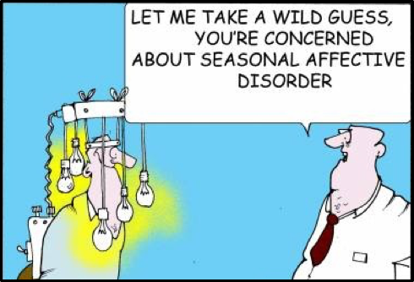
Seasonal Affective Disorder
Mood disorder (depression) that occurs during the winter
Treated with light therapy

Slide 44
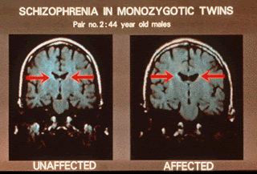
V. Schizophrenia Spectrum and other Psychotic Disorders (1)
Definition: characterized by distorted thinking and/or hallucinations and delusions
Epidemiology: 1% (rare)
Etiology
Dopamine Hypothesis
Genetics
Structural Abnormalities
Environment
Drug Usage

Slide 45
Schizophrenia
A person must experience TWO or more of the following during a 1 month period for this diagnosis
Delusions
Hallucinations
Disorganized Speech
Negative Symptoms
Grossly disorganized or catatonic behavior
Onset for men: teens and 20s vs. Women: 20s and 30s
Most severe and debilitating disorder-only 20% make a full recovery!
Must experience ONE of these

Slide 46
There are two main types
POSITIVE SYMPTOMS (EXCESSES)
NEGATIVE SYMPTOMS (DEFICITS)
Hallucinations
Delusions of Grandeur
Delusions of Persecution
Thought Disorder (word salad)
Neulogisms (new words)
Clang associations (rhyming)
Inappropriate affect (laughing when someone dies)
Flat Affect (no emotional response)
Catatonia (no movement)
Social withdrawal
Waxy Flexibility (poseable body)

Slide 47
Issues with treatment?
Tardive Dyskinesia: a side effect of treatment is Parkinson’s like symptoms
Involuntary and/or repetitive movements
Medications work to decrease dopamine.
Parkinson’s is associated with not enough dopamine

Slide 48
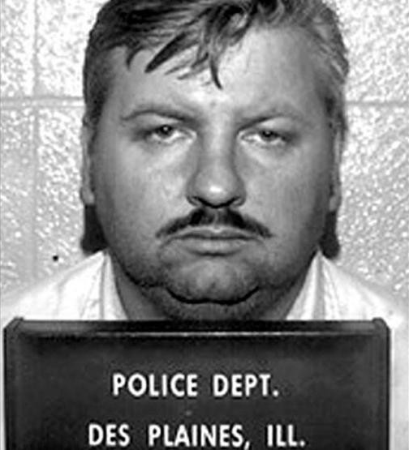
VI. Personality Disorders
Definition: well-established, maladaptive ways of behaving that negatively affect people’s ability to function
Epidemiology: 9%
Etiology
Modeling (dysfunctional family)
Strong genetic predisposition (67%)

Slide 49
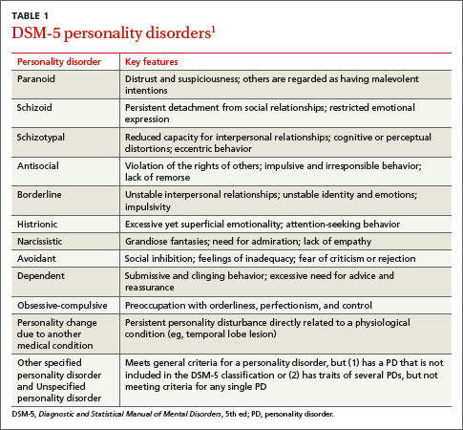

Slide 50
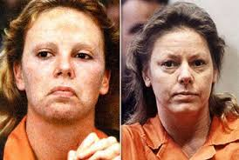
Antisocial Personality Disorder
Pattern of disregard for, and violation of, the rights of others
Failure to accept social norms; lack of empathy and guilt

Slide 51
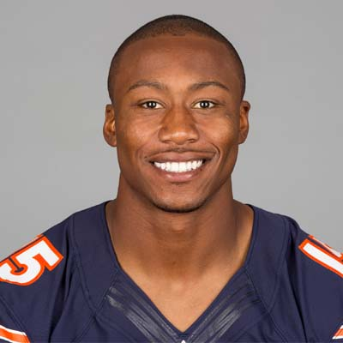
Borderline Personality Disorder
Pattern of instability in mood and interpersonal relationships
Very difficult to be alone, form intense and unstable relationships, and are often seen as manipulative

Slide 52
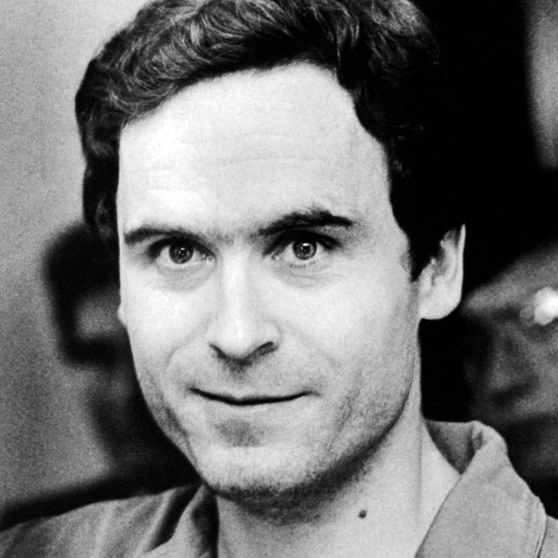
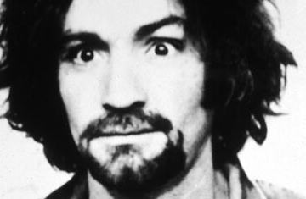
Psychopath
Sociopath
Charming, manipulative, well educated, planned crimes
Cause? Nature (genetics, amygdala)
Exs: Bundy, Gacy, BTK
Volatile, uneducated, disorganized crimes
Cause? Nurture (trauma, childhood)
Ex: Charles Manson?

Slide 53
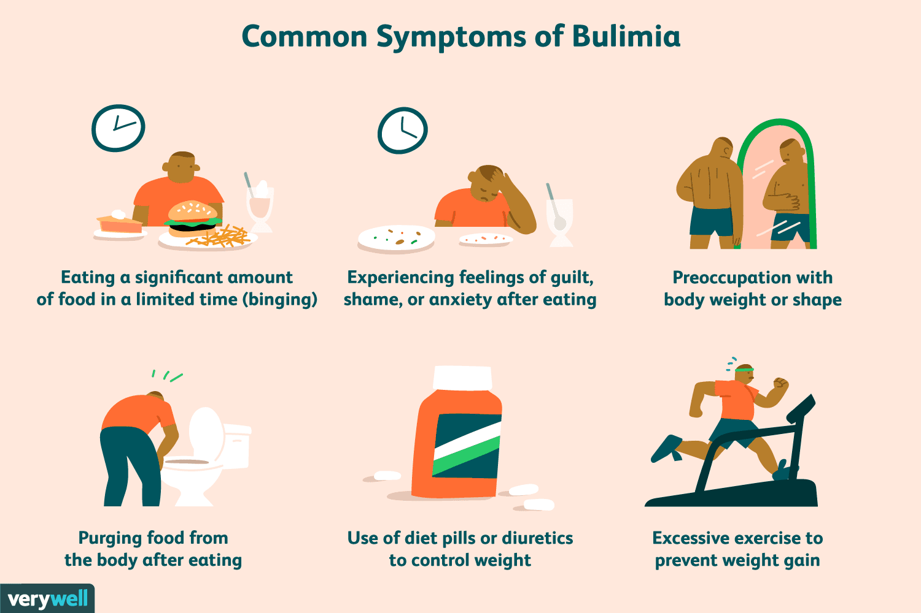
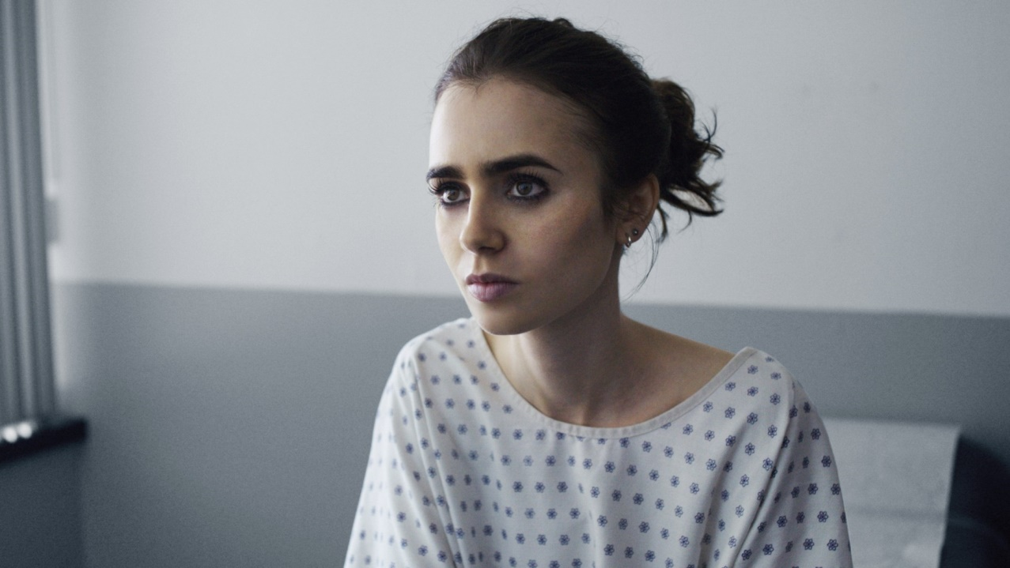
Feeding and eating disorders
Anorexia Nervosa
Bulimia
Distorted body image, an intense fear of fat and food, AND a loss of at least 15% of body weight
Distorted body image, an intense fear of fat and food, AND binge-purge cycle

Slide 54
Neurodevelopmental Disorders
Definition: deviations from typical social development
Autism Spectrum Disorders: deficits in social communicationa nd interaction, and repetitive patterns of behavior
Attention Deficit/hyperactivity disorder (ADHD): difficulty paying attention or sitting still

Slide 55
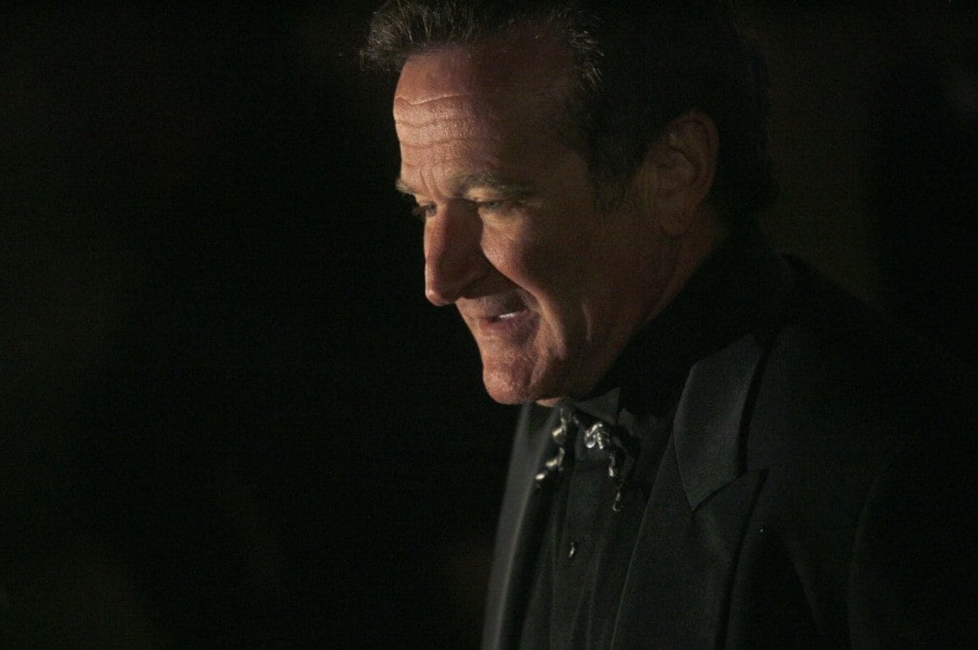
Let’s talk about suicide
10th leading cause of death
90% of suicides are committed by people who suffer from some type of psychological disorder

