Slide 1
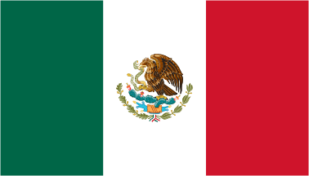
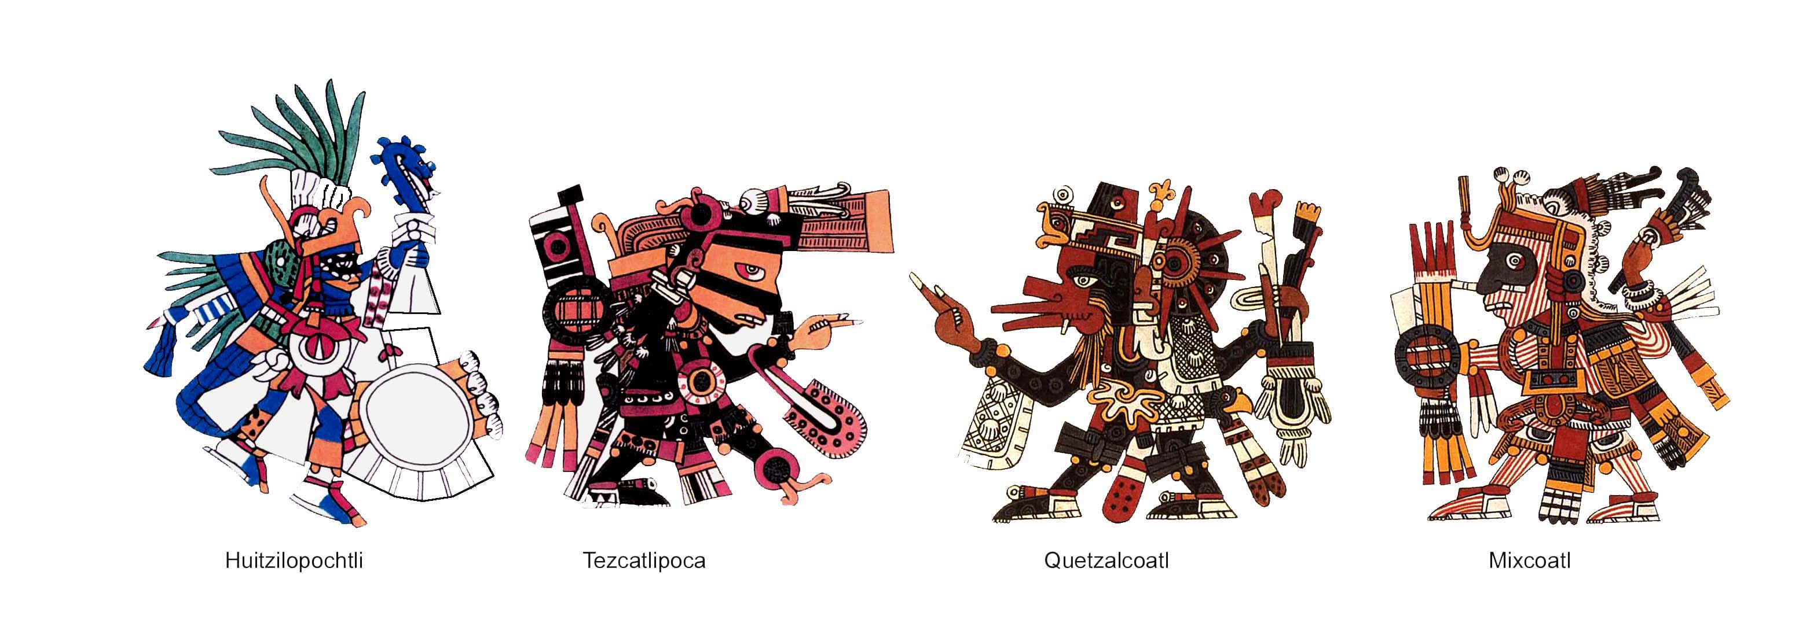
AZTEC

Slide 2
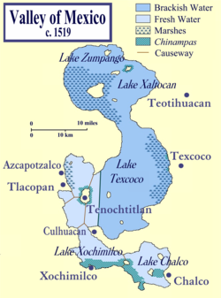
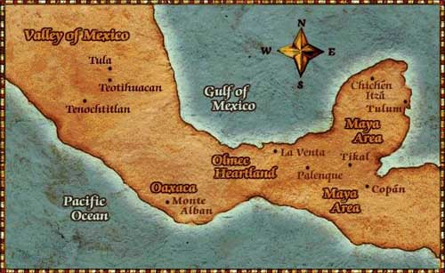
Valley of Mexico
Large, shallow lakes
Accessible resources
Fertile Soil

Slide 3
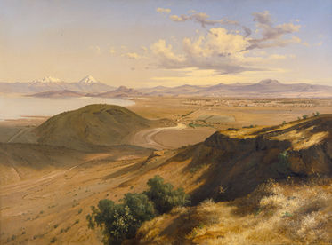
Teotihuacans
Toltecs

Slide 4
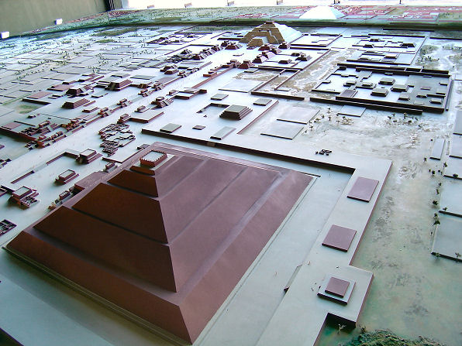
Teotihuacan = “City of the Gods”
Early city-state
100 A.D. - 500 A.D.
Largest city in world
125,000
Pyramid of the Sun
Trade → Obsidian

Slide 5
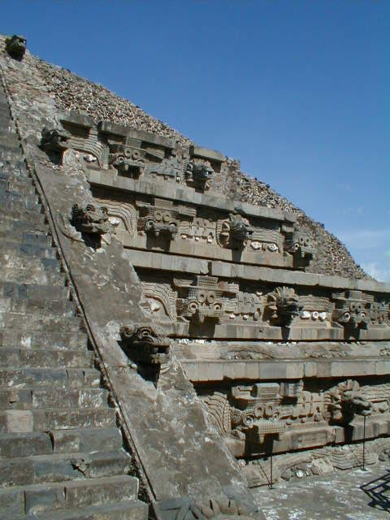
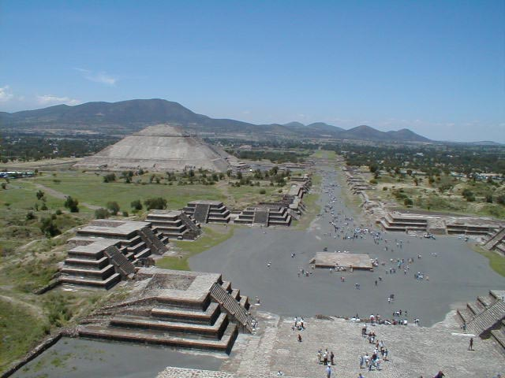

Slide 6
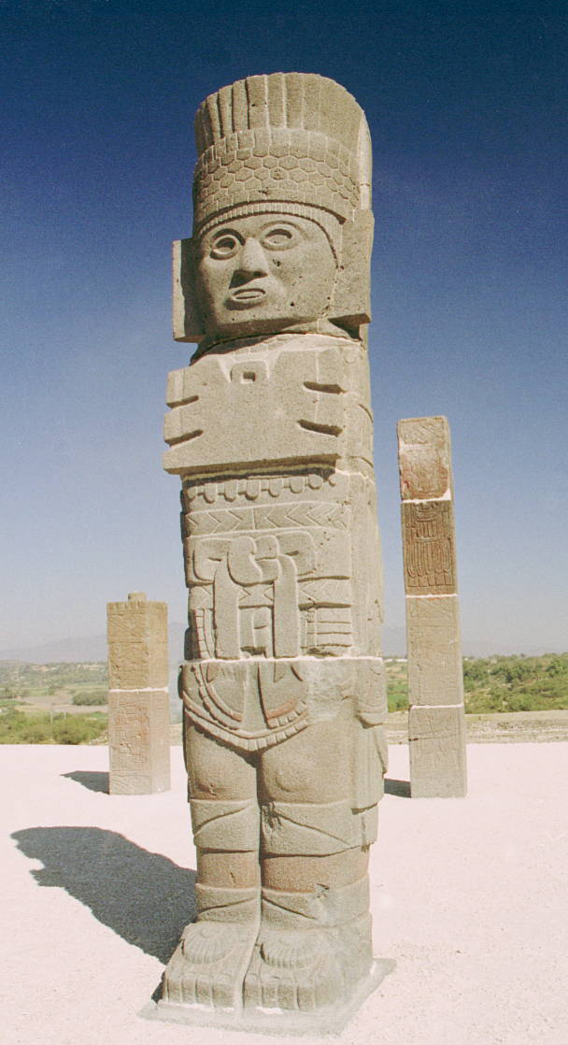
Toltecs
900 A.D.
Capital → Tula
Pyramids & temples
Empire based on conquest
Fierce war god
Human sacrifice

Slide 7
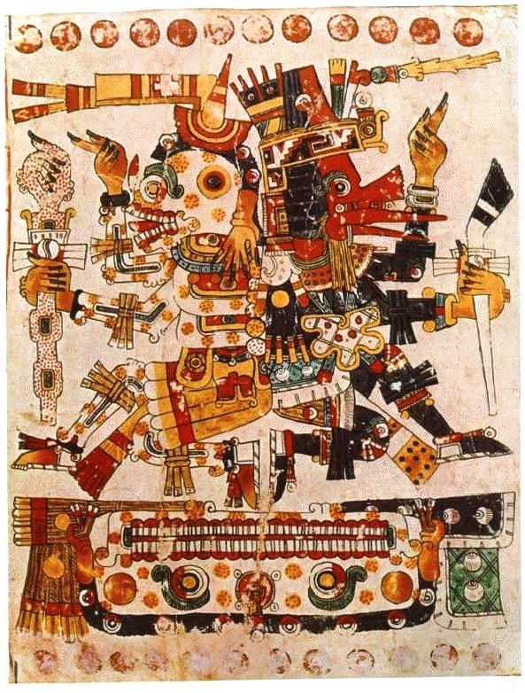
Quetzalcoatl Legend
Lived on as Myth
Exiled from Tula
Traveled east
Crossing sea on raft on snakes
Return one day
Bringing peace

Slide 8
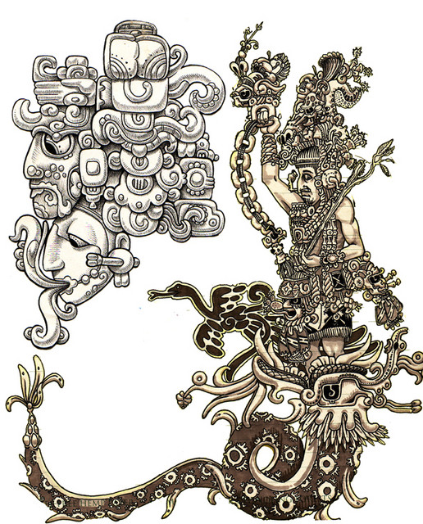
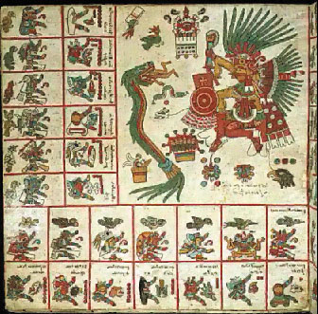

Slide 9
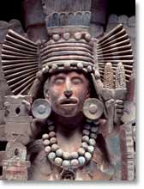
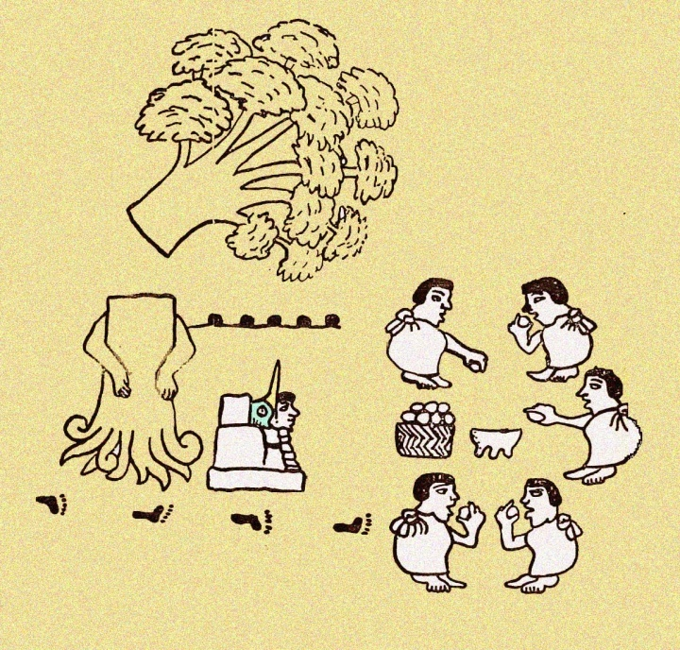
Aztecs
Valley of Mexico
1200 A.D.
Poor, nomadic
Fierce & ambitious

Slide 10
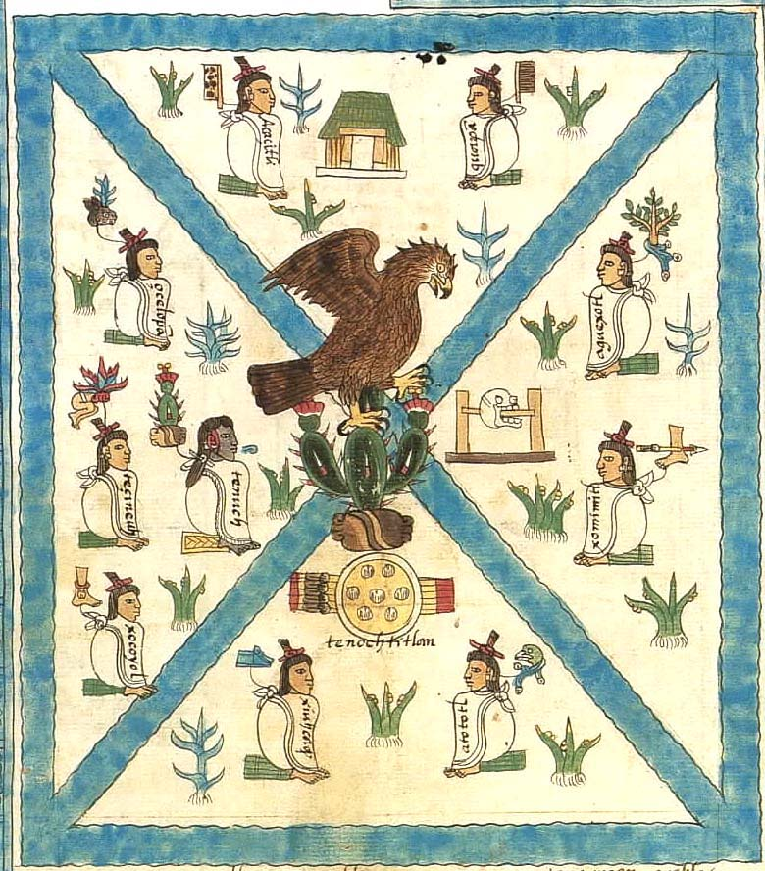
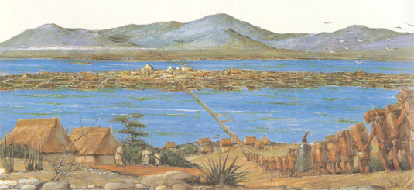
The Legend
Lake Texcoco
Tenochtitlan

Slide 11
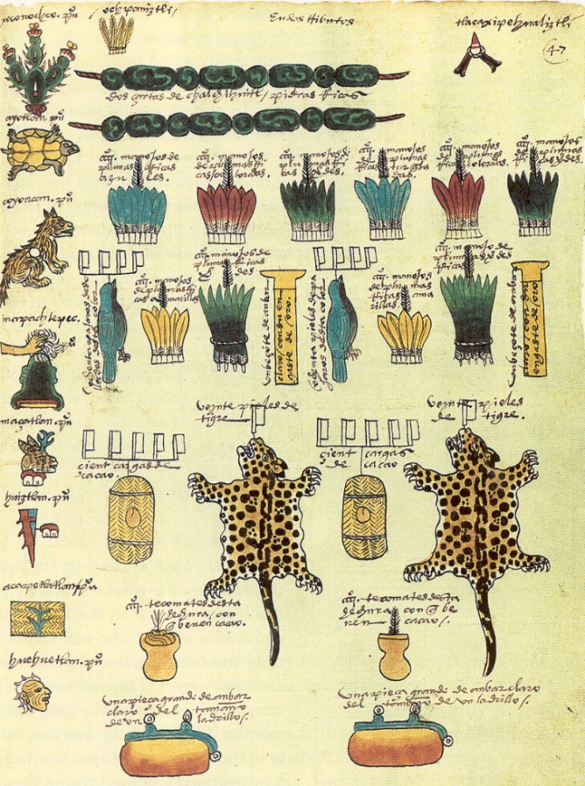
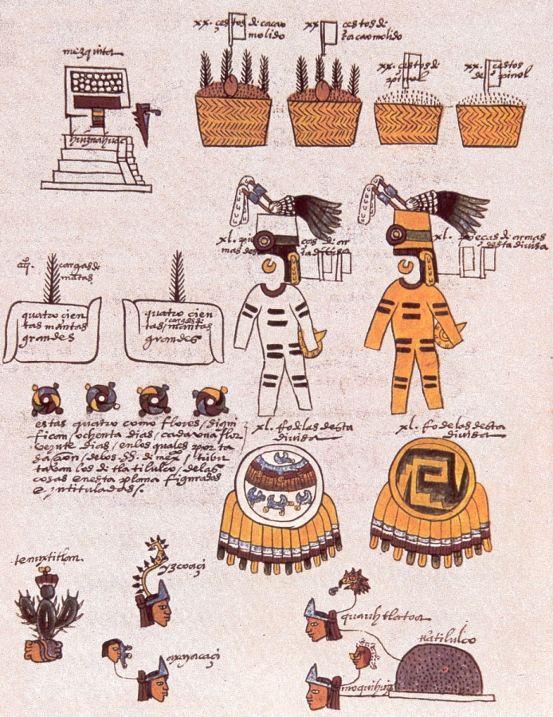
Tribute Demanded
Gold
Maize
Cocao beans
Cotton
Jade
PAY OR ELSE!

Slide 12
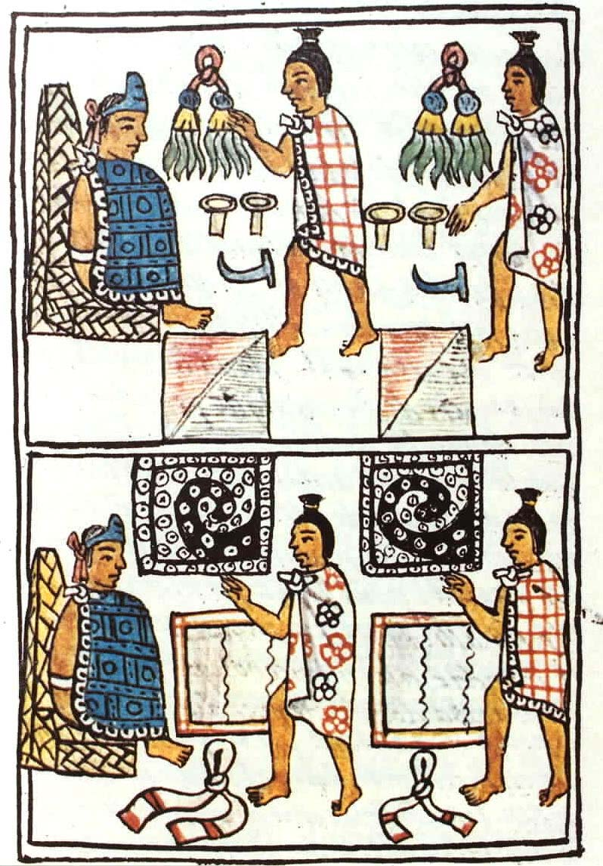
Social Class
Emperor
Absolute Power, god-king
Noble Class
Gov. officials, priests, military leaders
Commoners
Merchants, artisans, soldiers, farmers
Slaves
Captives

Slide 13
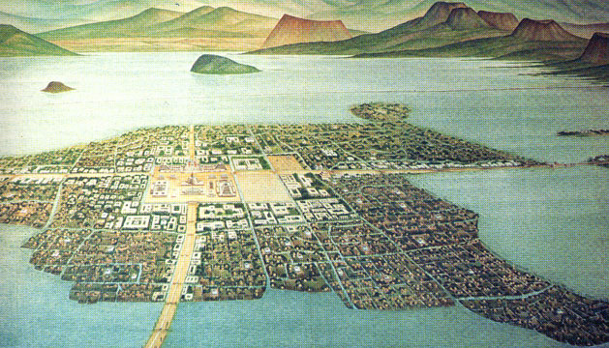
Tenochtitlan
Population 200,000
Causeways
Crops grown on
chinampas

Slide 14
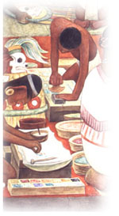
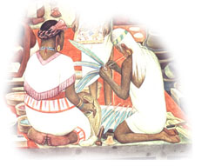
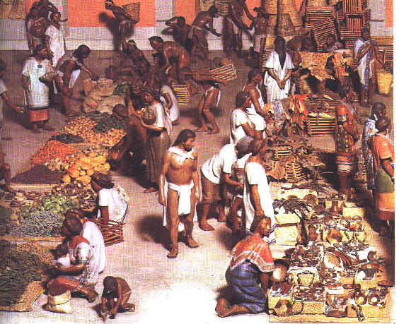
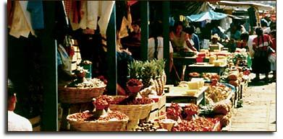
Tlatelolco Market
Economic heart of the city

Slide 15
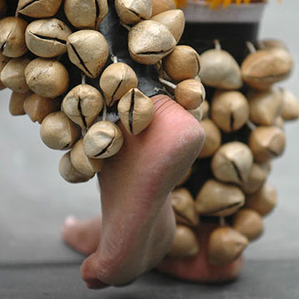
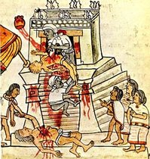
Religion
Adopted Toltec gods, worship
Elaborate public
ceremonies
Communicate w/gods & win favor
Human Sacrifice →
Sun god

Slide 16
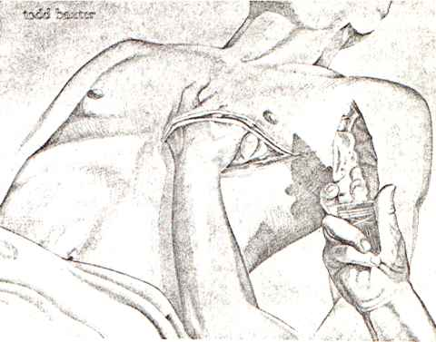
Sacrifice
Thousands of victims
Prisoners Of War (POWs)
Need war captives → New conquests
War tactics = live prisoners

Slide 17
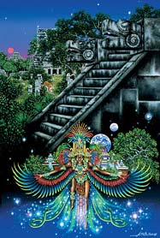
Problems Arise
Montezuma II (1502)
New emperor
Called for more tribute &
sacrifice=rebellion
Arrival of Spanish(1519)
“Return of Quetzalcoatl”
Hernando Cortes arrived with his conquistadors: Spanish Explorers
Conquered Aztecs bc of
Guns
Smallpox
Alliance with local tribes

